Slide 1

[Venue/Audience]
[Date]
[Speaker name and title]
Notes:
Add your Action Coalition logo in lower left corner
Please see the Sample Case for Support Messages document for additional information on using this presentation and tailoring messages for your state and your audience.

Slide 2
Topics
Overview
[NAME OF ACTION COALITION]’s Goals and Work
Your Role

Slide 3





The Reality
Health care is changing dramatically.
3
Notes:
Health care is changing dramatically—from the accessibility and high cost of care to the needs of a growing, aging and increasingly diverse patient population.
More people are struggling with chronic diseases, exacerbated by difficulty accessing primary and preventive care. Many people in [STATE] are insured for the first time and need to know how to navigate the complex health care system.
This time of change is also an important opportunity. As a country, we are beginning to understand the vital importance of helping people get healthy and stay healthy, with more community-based health services and an emphasis on wellness and preventive care.

Slide 4

The Potential
Nurses have the potential to lead us through this change and help build healthy communities.
Notes:
At this time of complex change, nurses have the potential to lead us through and help build healthy communities.
As the largest segment of our health care workforce, nurses will have the greatest impact on whether our communities are healthier tomorrow than they are today.
There’s a reason that, year after year, nurses are ranked as the country’s most trusted profession.
Nurses connect people to the care they need.
They lead, innovate and discover, all with the goal of improving care and supporting healthier communities.
As the frontlines of high-quality care, they also put those new discoveries and innovative policies into practice.
Nurses have a unique role, giving them unique potential to lead us through the transformation of health care.
NOTE: The case document includes additional audience-specific messages that you might substitute (or add) here based on who you are speaking with/presenting to.

Slide 5

The Solution
The future of health care in [STATE] depends on the future of
nursing.
5
Notes:
The future of health care in [STATE] depends on the future of nursing.
To address the health care challenges [STATE] is facing, we must equip nurses with the right tools and opportunities, whether they are pursuing an advanced degree, providing patient care or advocating for policy changes.
If we prepare our nurses for the health care system of tomorrow, they will lead us there.
They will improve the health of our citizens, strengthen our economy and advance our state.

Slide 6
The Solution
At [NAME OF ACTION COALITION], our fundamental goal is to promote a culture of health, ensuring that consumers get the care they need, when and where they need it.
We can’t do that without nurses.
Notes:
The [NAME OF ACTION COALITION] is part of a nationwide, collaborative effort to advance the nursing profession, The Future of Nursing: Campaign for Action.
Our fundamental goal is to promote a culture of health, ensuring that patients get the care they need, when and where they need it.
We can’t do that without nurses.
The [NAME OF ACTION COALITION] is part of a nationwide, collaborative effort to advance the nursing profession, The Future of Nursing: Campaign for Action.
We have brought together a coalition of nurses, other health care providers, insurers, businesses, educators, researchers consumers and policymakers. All of these partners are committed to advancing nursing to ensure all [STATE] residents have access to high-quality, accessible, cost-effective care.
[Alternate second paragraph for Action Coalitions aligned with nursing workforce centers:]
We are also an integral and integrated part of [NAME OF WORKFORCE CENTER]. Through this partnership, we bring together leaders from across the nursing field and the health care sector to ensure that our state’s nurses have the skills and knowledge to drive high-quality, accessible, cost-effective care for people across [STATE].

Slide 7



Your Role
And we can’t do it without you.
Notes:
Your support makes our work possible.
The work we are all doing together depends on the support of corporate partners, foundations, and individual supporters.
Note: Include a brief overview (~one sentence) about what philanthropy will allow your Action Coalition to do.

Slide 8
Topics
Overview
[NAME OF ACTION COALITION]’s Goals and Work
Your Role

Slide 9
Snapshot: Our Health
What facts give a snapshot of the health of your state’s population and demand for care? These could be:
  Disease incidence ratings
  ACA-related demand among newly insured
  Demographics, particularly population growth or significant senior population
Notes:
I want to tell you more about the work that we’re doing, but first I want to give you a sense of why that work is important here in [state].
The challenges we’re seeing nationally related to our population’s health are no less challenging here at home.
What facts give a snapshot of the health of your state’s population and demand for care? These could be:
Disease incidence ratings
ACA-related demand among newly insured
Demographics, particularly population growth or significant senior population

Slide 10
Snapshot: Our Health Care
What facts “make the case” for the importance of nurses in your state? These could be:
  Nursing shortages
  Nursing faculty shortages
  Primary care physician shortages
  Policy challenges, such as barriers to practice
Notes:
At the same time, systematic challenges such as [XX] prevent us from adequately addressing the changing and rising demand for care in our state.
What facts “make the case” for the importance of nurses in your state? These could be:
Nursing shortages
Nursing faculty shortages
Primary care physician shortages
Policy challenges, such as barriers to practice

Slide 11
Our Vision
Everyone in America can live a healthier life, supported by nurses as essential partners in providing care and promoting health equity and well-being.
Notes:
If your Action Coalition has its own vision/mission, insert it here. Otherwise, use the Campaign’s vision.
[Action Coalition name] was established to ensure that our state is ready to meet the health care needs of our population today, tomorrow and well into the future.
What drives our work is the vision that [everyone in America can live a healthier life, supported by a system in which nurses are essential partners in providing care and promoting health.]
I mentioned earlier that we are part of The Future of Nursing: Campaign for Action. This initiative was established to carry out the recommendations of the landmark Institute of Medicine report, The Future of Nursing: Leading Change, Advancing Health.
So how do we carry out our vision?

Slide 12
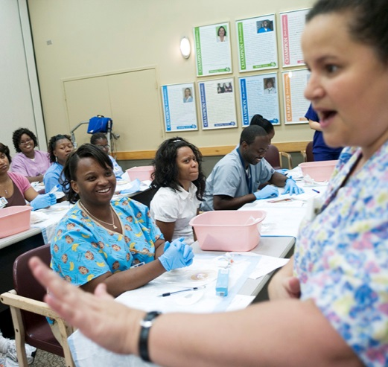


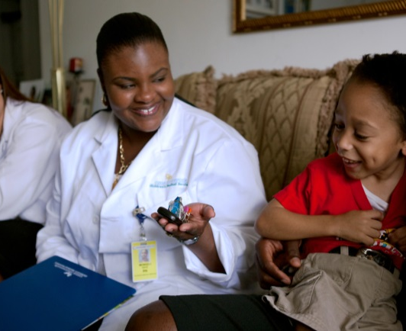

Our Goals
Education
Practice & Care
Leadership
Image to come
Diversity
Interprofessional Collaboration
Workforce Data
Notes:
Delete any on slide and below that do not apply to your state
Based on the specific needs of our state, we are focused on [#] core goals, drawn from the Institute of Medicine report, The Future of Nursing: Leading Change, Advancing Health. [shorten to IOM’s Future of Nursing report if previously referenced]
These goals are:
Advancing education. We need to prepare our nursing workforce to serve growing and changing consumer needs in the future by strengthening and modernizing education and supporting a strong pipeline of future nurses.
Removing barriers to care. Outdated policies prevent consumers from full and open access to high-quality care. By working to remove these unnecessary nursing-policy barriers, we will expand consumers’ access to care and reduce costs.
Empowering nurses as leaders. With more nurses in leadership positions across the health care sector—from board members and faculty to policymakers and hospital leaders—we will be better able to enact change that reflects the realities of the individuals, families and communities nurses serve.
Promoting diversity. Our work helps ensure that the nursing profession is equipped to provide culturally competent care in a variety of settings to an aging and more ethnically diverse population with more chronic illnesses.
Fostering interprofessional collaboration. When provider teams work together, they can offer higher-quality, more effective care. We are working to promote a team-based approach to education and care that positions nurses as partners.
Bolstering workforce data. Building a nursing workforce able to meet current and emerging needs can only happen if we know what that workforce needs to look like. We are creating tools that track our needs and our progress so that we can work toward the common goal of promoting a culture of health throughout [STATE].

Slide 13
Topics
Overview
[NAME OF ACTION COALITION]’s Goals and Work
Your Role

Slide 14
How You Can Help
What initiatives or other priorities will donors/funders’ support help you expand, continue or launch? What is the anticipated impact of each priority?
If no defined priorities exist, how would you describe what contributed support will allow you to accomplish that you wouldn’t otherwise be able to?
Notes:
Your support will make a difference to ensure patients get the care they need, when and where they need it.
[See the Case for Support Materials resource guide for info on defining giving priorities.]

Slide 15
How You Can Help
The future of health care depends on the future of nursing,
and the future of nursing
depends on you.
Notes:
The future of health care depends on the future of nursing, and the future of nursing depends on you.
NOTE:
If a prospect is still early in cultivation, delete this slide and conclude the presentation with discussion about where their interests align with the work of the Action Coalition.
If you are presenting to a broad audience, keep this slide and conclude with:
“We would love to talk more with you about how we can work together to advance nursing and improve health throughout our state.”
If a prospect has been fully cultivated and you are presenting this at a solicitation meeting, keep this slide and conclude with:
Please join us in supporting our nurses—and ultimately patients throughout our state—with a $XX gift to [ACTION COALITION].

Slide 16
How You Can Help
Insert website and/or contact information here

