Slide 1

Taking the LEAD for Nursing:
Leadership, Educational Advancement & Diversity
Celebrate Nursing in Wisconsin!
Aurora Health Care, Summit WI
January 15, 2015

Slide 2
Welcome!
Carolyn Krause, PhD, RN
President – Board of Directors
Wisconsin Center for Nursing, Inc.

Slide 3

Wisconsin Action Coalition
Goal: Implement IOM Future of Nursing Report
Co-leads:
    Wisconsin Center for Nursing
    Rural Wisconsin Health Cooperative
    In collaboration with stakeholders:
    Educators, practice members, business leaders, legislators, policy-makers, consumers, etc.

Slide 4

National Level Leadership
Robert Wood Johnson Foundation®
    State Implementation Program Grants (SIP)
Center to Champion Nursing in America
AARP
www.campaignfornursing.org

Slide 5

Keynote Address
Sam Wilson, State Director
AARP Wisconsin
The AARP & Future of Nursing™ Connection:
State & National Picture

Slide 6
Wisconsin Update
Judith Hansen, Executive Director
Wisconsin Center for Nursing
Implementing the IOM Future of Nursing Report: Progress in Wisconsin

Slide 7
Mission
Assure an adequate, well-prepared and diverse nurse workforce for the people of Wisconsin

Slide 8
Data-based Workforce Planning
WI population projections - 1.5 million increase by 2034
24% increase - people 65+
133% increase - people 85+
Increasing diversity
Complex health needs, changing systems
Aging workforce
Aging educators

Slide 9
WCN Data Model
Diversity
RN and LPN
Workforce Report Products
Education
DWD Forecasting Models
IOM Report Recommendations

Slide 10
2014 Wisconsin RN Survey
Summary results – just published
Volunteer researchers – UW Madison, UW Oshkosh, UWM, & Marquette University
Full report & regional breakdowns – Feb, 2015
Total responses - 83,918 (paper - 2,728)
Do not live or work in Wisconsin - 6,615
Valid online responses after data cleaned n=73,136

Slide 11
2014 Wisconsin RN Survey

Slide 12
2014 Wisconsin RN Survey

Slide 13
2014 Wisconsin RN Survey

Slide 14
2014 Wisconsin RN Survey
% Race -Ethnicity | Caucasian | African American | Hispanic | Asian | Other
2012 | 93.5 | 2.0 | 1.4 | No data | 3.0
2014 | 95.1 | 1.8 | 1.6 | 1.4 | 1.6

Slide 15
2014 Wisconsin RN Survey
Wisconsin Nurses by Gender | % Female | % Male
2010 | 93.2 | 6.8
2012 | 93.1 | 6.9
2014 | 93.1 | 6.9

Slide 16
2014 Wisconsin RN Survey

Slide 17
2014 Wisconsin RN Survey
Advanced Practice RNs (APRNs)
Certified to practice as APRN - 4,417 (6%)
Certified prescribers - 2,712
Working in role requiring APRN in Wisconsin 3,703 (6.1%)

Slide 18
2014 Wisconsin RN Survey
Nurses Serving as Appointed or Elected Leaders
Of 73,136 valid responses:
    966 appointed to governance boards (1.3%)
    307 elected officials –county boards, schools boards, etc. (0.4%)

Slide 19
Taking the LEAD for Nursing in WI
RWJF SIP # 70696
Focus areas:
Leadership, Educational Advancement & Diversity
Implementation of related IOM recommendations:
    80% BSN by 2020
    Increase readiness for leadership & presence of nurses on boards
    Increase diversity & representation from under-represented groups
Unique elements: Wisconsin Dashboard, Funders Network & IOM progress report

Slide 20
Funders Network
Leaders from health systems & development offices, schools, local foundations
GOAL: Partnerships to advance nursing education
Public Policy Forum Research Brief –Seeking Strategies to Address Wisconsin’s Nursing Shortage - Faye McBeath Foundation
Regional meetings - Madison & Fox Valley; planning SE & NW Wisconsin
Unique approach in nation

Slide 21
IOM Report: Wisconsin Progress
National Summit, Washington, DC Feb, 2013
Need to assess status of IOM implementation in Wisconsin
WI AC Advisory Council committee
Survey based on IOM recommendations
Disseminated statewide w/ help of many partners, stakeholder groups
Responses compiled by team - WCN Board of Directors

Slide 22
IOM Report: Wisconsin Progress
121 responses
All 5 phone area codes of state
Nursing education, hospital & clinic systems, LTC facilities, C/PH agencies, school districts, professional nursing associations, etc.
Over 500 comments
‘One of kind’ report in nation:
Implementation of the IOM Future of Nursing Report: A Wisconsin Profile

Slide 23
Results: Wisconsin IOM Progress
 | Hospitals Clinics | Nursing Education | Other | All
Is your organization taking action to: | n=51 | n=43 | n=27 | n=121
Remove scope-of- practice barriers? | 63% | 70% | 41% | 60%
Expand opportunities for nurses to lead improvement efforts? | 80% | 56% | 52% | 65%
Implement nurse residency programs? | 76% | 30% | 11% | 45%
Increase proportion of nurses with BSN to 80% by 2020? | 80% | 88% | 48% | 76%

Slide 24
Results: Wisconsin IOM Progress
 | Hospitals Clinics | Nursing Education | Other | All
Is your organization taking action to: | n=51 | n=43 | n=27 | n=121
Double number of nurses with doctorate by 2020? | 31% | 56% | 19% | 37%
Ensure nurses engage in lifelong learning? | 78% | 88% | 78% | 82%
Prepare & enable nurses to lead change to advance health? | 76% | 70% | 59% | 70%

Slide 25
Results: Wisconsin IOM Progress
 | Hospitals Clinics | Nursing Education | Other | All
Is your organization taking action to: | n=51 | n=43 | n=27 | n=121
Build infrastructure for collection & analysis of interprofessional health care workforce data? | 47% | 74% | 30% | 53%
Enhance models of inter- professional education & practice? | 39% | 70% | 19% | 45%
Increase nursing diversity? | 59% | 86% | 41% | 64%

Slide 26
Report Recommendations
Indicators for continuing work in Wisconsin:
1. Double #nurses w/ a doctorate by 2020.
2. Implement more nurse residency programs, including community-based residencies.
3. Increase diversity in the nursing workforce & nursing faculty.
4. Enhance models of interprofessional education & practice.
5. Standardize data collection for all healthcare professionals

Slide 27

Diversity
Barbara Nichols, DHL, MS, RN, FAAN
LEAD Project Coordinator

Slide 28
Diversity Model in Wisconsin
SIP Grant – 3 learning collaboratives –
Leadership, Educational Advancement, & Diversity
Goal:
Infuse diversity into work
of each collaborative

Slide 29

USA – Changing Demographics
Diversity needs to be viewed through changing demographics of race, ethnicity, religion, and age.

Slide 30
The Wisconsin Nursing Workforce
Why Diversity ?
Enhances communication
Promotes patient satisfaction, compliance
Improves access to care
Assists in addressing disparities
Provides diverse perspectives to solve complex problems

Slide 31
Taking the LEAD for Nursing in WI -
Diversity
Collect, analyze, integrate & utilize data to develop evidence-based strategies
Build partnerships across multiple & diverse stakeholder groups
Promote, target & sustain diversity efforts across educational & practice settings
Create direct outreach approaches that engage diversity groups & stakeholders

Slide 32
Diversity Activities
WCN 2012-13 Diversity Taskforce report
Diversity conference: Cultivating a Diverse Nursing Workforce in Wisconsin June 2013
Minority nursing organizations – meetings to engage in work, projects
Wisconsin chapters - American Association Men in Nursing (AAMN)

Slide 33
Diversity Report Recommendations
Make diversity an organizational priority
Provide support mechanisms for under-represented populations in both academic & practice settings
Train staff & students to ensure higher levels of cultural competency
Develop a standardized system for tracking diversity data in nursing programs & health systems
Join forces for a statewide initiative for scholarships for under-represented populations

Slide 34
Diversity Resources
Enhancing Diversity in the Nursing Workforce Report
Fact Sheet, powerpoint presentations , infographic
Diverse Stellar Students http://www.wisconsincenterfornursing.org/student_spotlight.html
Professional Profiles in Diversity http://www.wisconsincenterfornursing.org/wiAC-LearningCollaboratives%20-%20Diversity.html
  Wisconsin Diversity Assessment Tool
Toolkit for recruitment & retention of minority students

Slide 35

Leadership
Barbara Nichols, DHL, MS, RN, FAAN
Project Coordinator

Slide 36
Objectives
Overarching goal:
Increase number & preparedness of nurse
leaders
Increase RN presence on targeted boards by 10%
Increase RN leadership training by 20%
Enhance leadership education in pre-licensure programs
Develop leadership resources, board training

Slide 37
2013 Nursing Leadership Through Board Service Survey
Overview
Synopsis of major findings
Recommendations

Slide 38
Overview n=866
96.5% female; 3.5% male
Majority White & female
Limited male & ethnic representation
Majority BSN, followed by MSN
Greatest board service on community boards, followed by professional nursing organizations at state level

Slide 39
Overview, continued
Synopsis:
41% serving on one board; 25% serving on 2 boards
Qualifications:
  Significant expertise
  Met statutory or bylaw requirements
  Strong decision-making ability
  Strategic thinking skills

Slide 40
Overview, continued
Most helpful assistance for board service:
  Formalized board training, identification of organization boards, mentorship, review of parliamentary procedure, review of major healthcare trends
Underrepresentation on health system & insurance boards

Slide 41
Targeted Boards Surveys
Targeted Board Survey sent to Deans of Schools of Nursing, CNOs, FQHCs, non-profits.
Results the same as Nurses on Boards Survey

Slide 42
Leadership Through Board Service Survey
Recommendations
Establish a central repository of board opportunities
Include board skills in structured education programs
Establish and disseminate board composition and opportunities to nurses
Establish formal board mentorship programs
Add board leadership curricula in UG and Grad programs

Slide 43
Environmental Scan
4 Leadership Initiatives
WONE Nurse Leadership Academy
UW Madison Clinical Leadership Institute
WI Department of Corrections Leadership Training
Rural WI Health Cooperative Leadership Training

Slide 44
Environmental Scan
4 Leadership Initiatives
Eligibility
Number of participants
Diversity
Length of program
Courses
Times offered

Slide 45
Enhance Leadership Education
Curricular Review process
Leadership course objectives
Pre-licensure programs
Convenience sample included private/public schools, BSN/ADN programs

Slide 46
Enhance Leadership Education
Key factors identified:
Common themes & objectives
Key learning exemplars & promising practices
Limitations & gaps identified

Slide 47
Enhance Leadership Education
Recommendations:
Widely disseminate findings
Integrate leadership concepts across curriculum
Recognize content as evolving
Ongoing communication
Focus on active learning

Slide 48
Enhance Leadership Education
Recommendations (continued)
Establish systematic collaboration for a gap analysis for BSN-completion programs
Establish education group forums across schools
Continue leadership development beyond formal academic program

Slide 49
Leadership Resources
Reports
Nursing Leadership Through Board Service
Review & Analysis of Leadership Curricula in WI Undergraduate Nursing Programs
Leadership Toolkit to include resources for nurse board service
Nurses on Boards trainings (4) summer, 2014 – 100+ participants

Slide 50

Educational Advancement
Stephanie Stewart, PhD RN
Project Coordinator

Slide 51
Objectives
Develop Midsize Pilot for Academic Progression
Introduce Rural Pilot for Academic Progression
Highlights from 2011, 2012 & 2013 Education survey
Highlights from Survey of Wisconsin CNO’s
Infographic for RN to BSN Completion in Wisconsin
Thank you to collaborative, committee members

Slide 52
BSN Completion – Midsize Pilot
Bellin Health & Bellin College
Laura Heib, CNO Bellin Health committed to 80% BSN by 2020
Discussions with CEO and CFO
Collected baseline information
Survey nurses at Bellin Health
54% BSN or higher (> 900 nurses)
39% return rate from diploma & ADN nurses

Slide 53
BSN Completion – Midsize Pilot
Review of literature & nursing accreditation standards
Program decisions:
120 credits: 64 nursing credits & 56 general education credits
70 credits accepted via transfer for ADN or Diploma
34 nursing, 36 general education

Slide 54
BSN Completion- Midsize Pilot
30 Bellin College credits are required for residency.
10 general education credits are required:
4 cr. Statistics course
3 cr. Diversity course
3 cr. Ethics course
1 cr. Expository Writing course
Remaining general education credits made up of humanities, social sciences & general courses

Slide 55
BSN Completion- Midsize Pilot
General education requirements from previous bachelor’s degree accepted
Courses taught over 8 week sessions
Community clinical capstone – full semester
Writing emphasis throughout the curriculum
Curriculum plan designed to be practice-oriented
Practice/Education collaboration

Slide 56
BSN Completion - Rural Pilot
Black River Falls Hospital & UW Eau Claire
Spring 2014 Readiness Survey
Shared results with nurses May 2014
Working with UW Eau Claire to encourage nurses to return for BSN
Presentation this afternoon by participants

Slide 57
2013 Wisconsin Nurse Education & Nurse Faculty Survey
91% response rate
39 out of 43 Nursing Programs completed the survey
Thank you to Barb Pinekenstein & Brent MacWilliams co-investigators

Slide 58
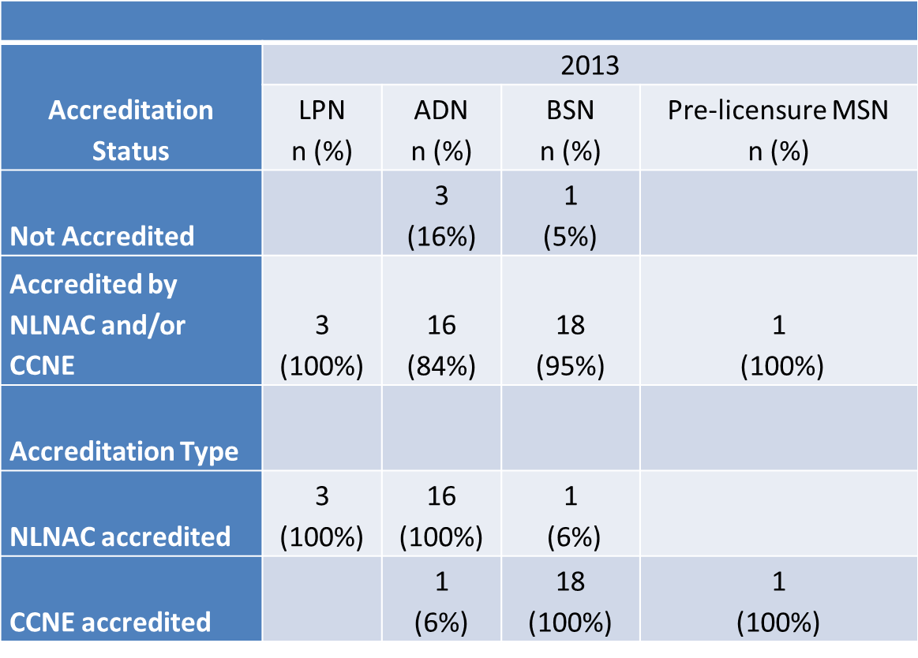
Accreditation Status

Slide 59
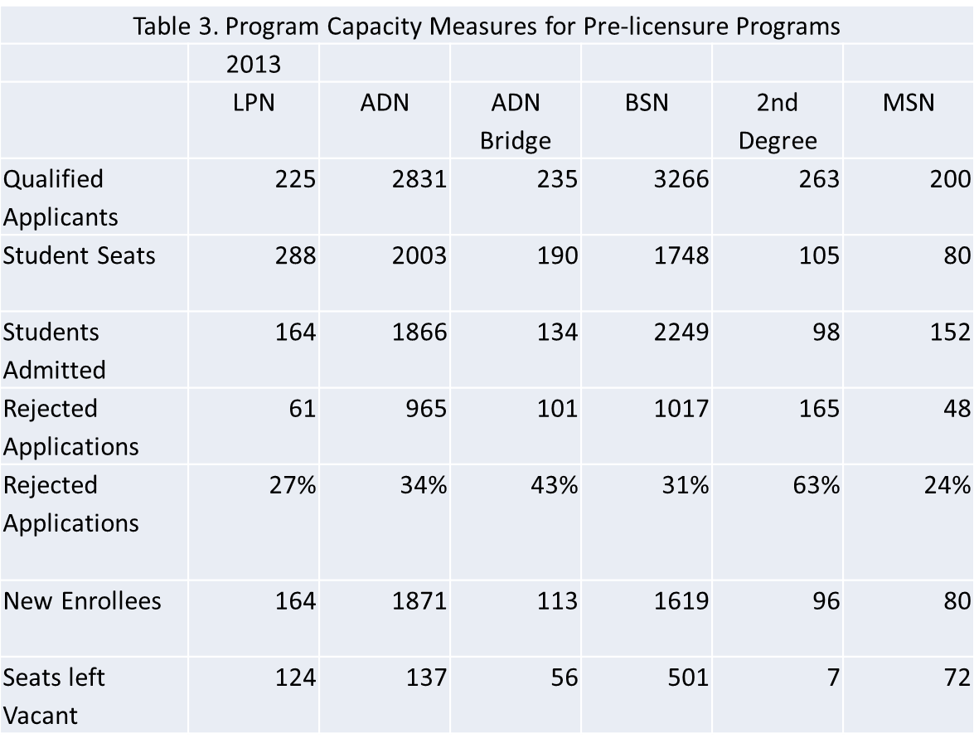
Program Capacity Pre-licensure

Slide 60
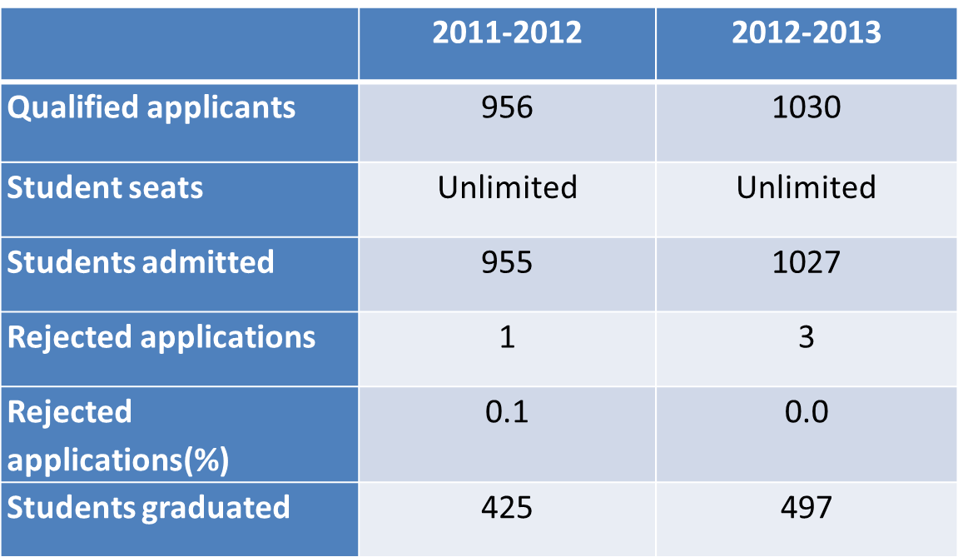
RN to BSN

Slide 61
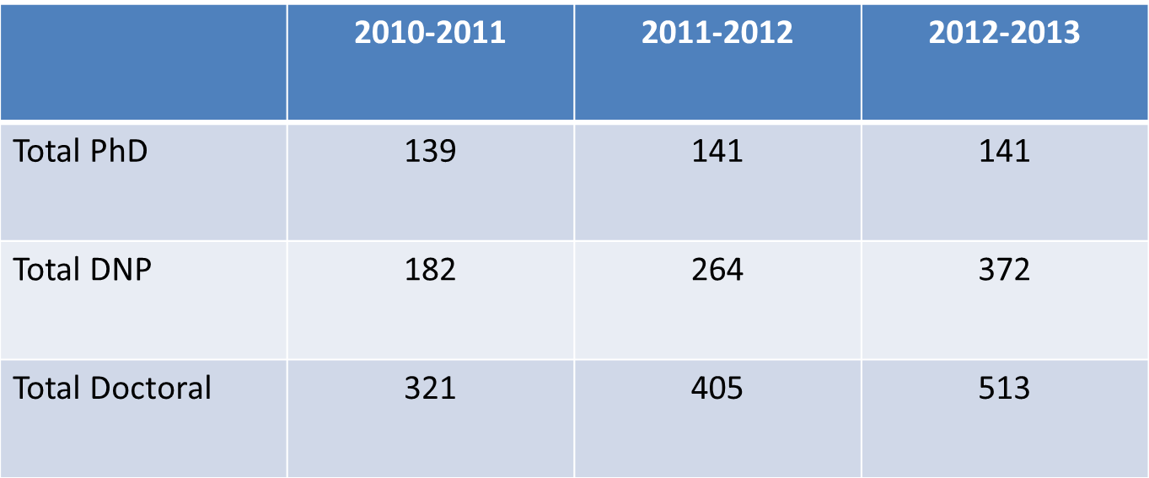
PhD/DNP Enrollment

Slide 62
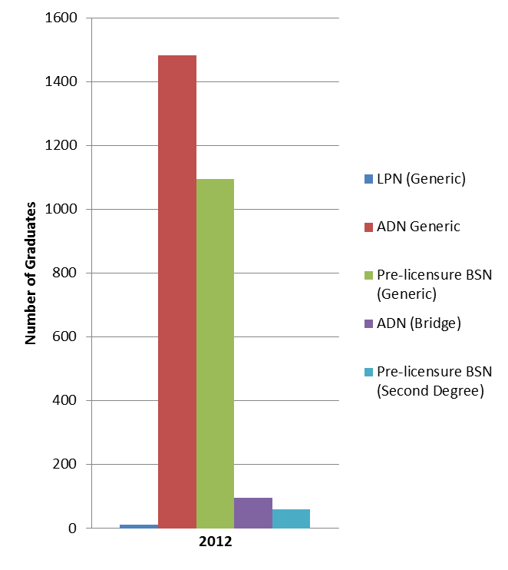
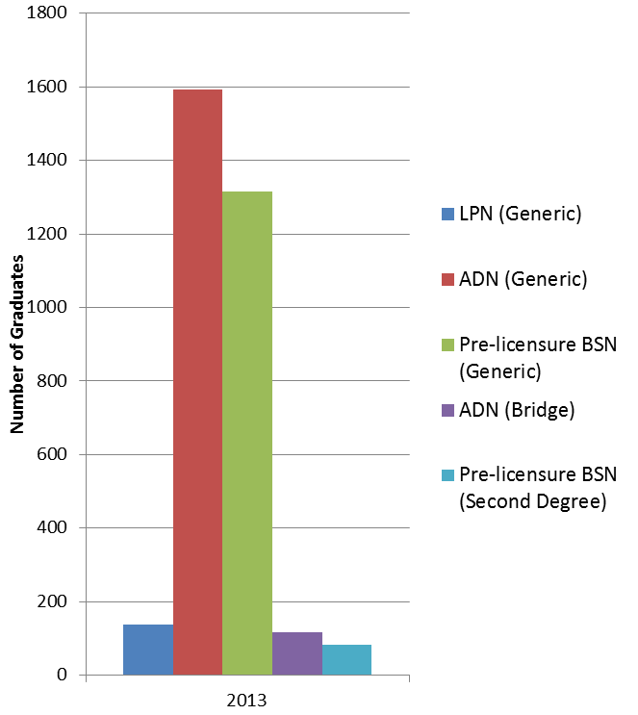
Number of Graduates from
Pre-licensure Programs

Slide 63
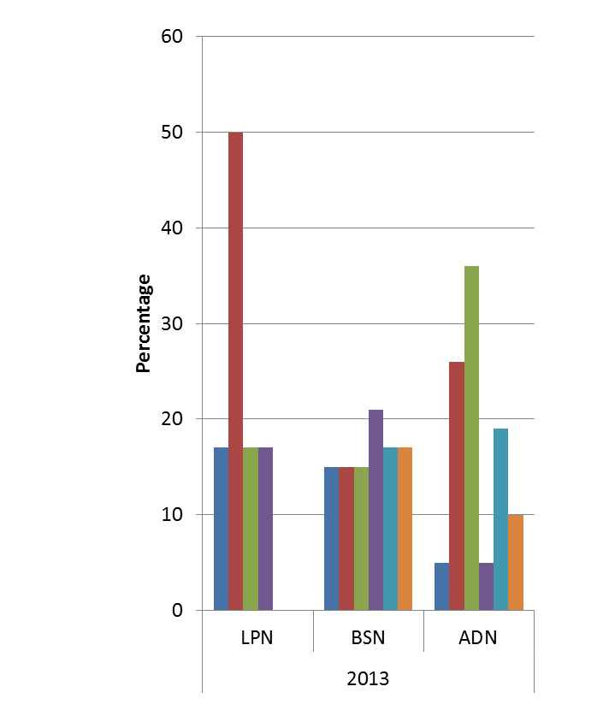
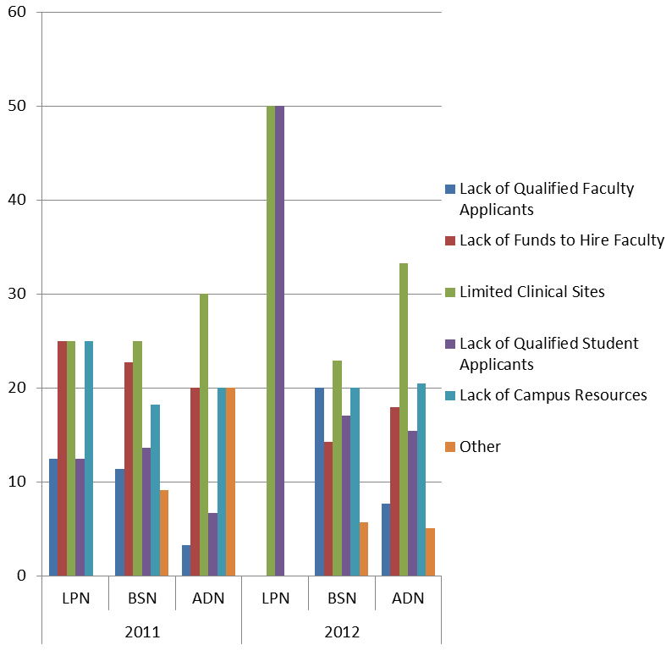
Factors Limiting Pre-licensure Student Admissions

Slide 64
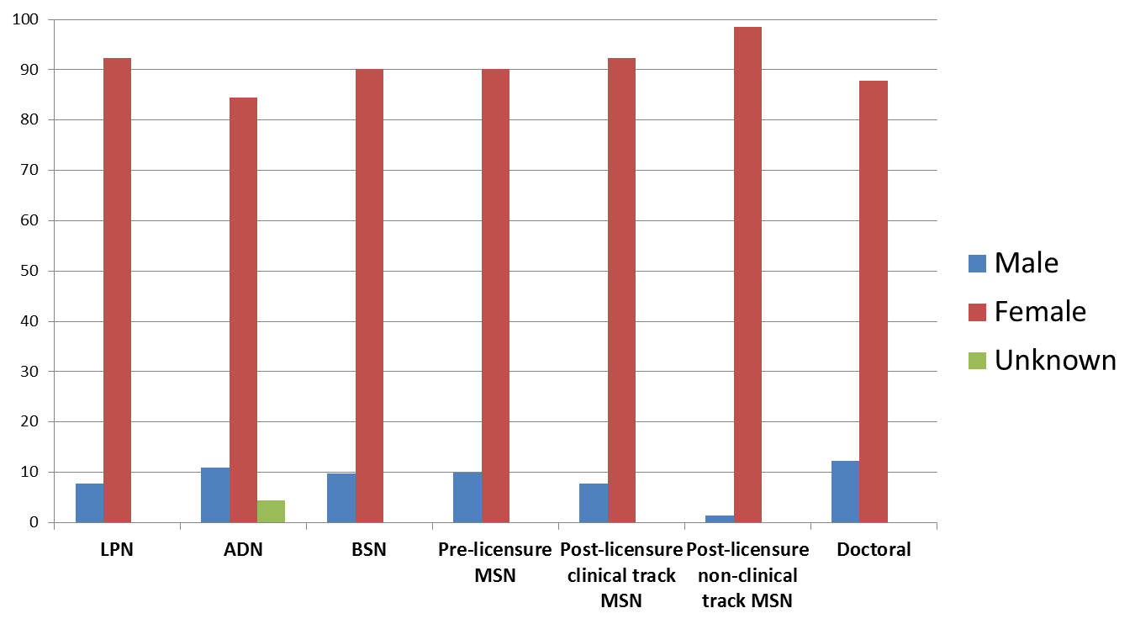
Gender of Nursing Students 2013

Slide 65
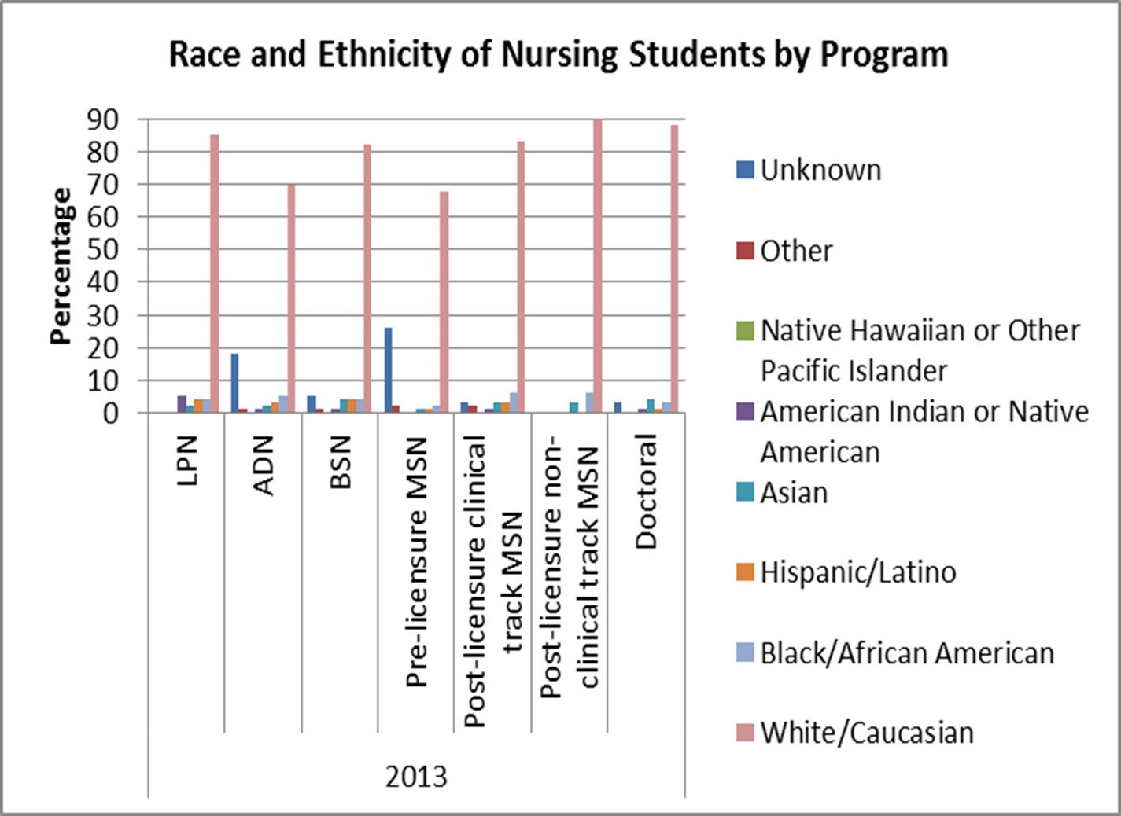

Slide 66
Summary
Continue efforts to increase response rate to 100%.
Evaluate potential strategies to address factors limiting enrollment, especially related to limited clinical sites for pre-licensure and advanced practice nursing programs.
Encourage development of pathways for students from diverse backgrounds to become nursing faculty.
There appears to be an increase in ADN graduates in WI
Encourage & support BSN completion in Wisconsin.

Slide 67
Collaboration with WONE
Wisconsin Organization of Nurse Executives
Survey developed for hospitals to determine
academic progression strategies
Sent to CNOs at hospitals & healthcare facilities in the state
Five minute survey

Slide 68
Wisconsin CNO Survey
Surveyed 82 CNOs in Wisconsin from October to December 2014, hospitals & medical centers
Primarily hospitals, medical centers
Approved by RWJF, UW Oshkosh IRB
Collaborated with WONE and Peggy Ose for development of Survey
Push/Pull Sub committee assisted with design of survey

Slide 69
Wisconsin CNO Survey
Used Qualtrics with emailed link
Sent to CNOs several times
Left link open with several requests to complete survey
Survey results were returned from 41 CNOs
50% return rate from the sample we surveyed

Slide 70
BSN Hiring Practices
Educational preparation you require in hiring staff nurses.
  ADN n=30, BSN n=4, No requirement n=7
Educational preparation you prefer
  ADN n=2, BSN n=39
Is hiring BSN-prepared nurses part of your facility’s strategic plan for the future?
  Yes n=30 No n=11

Slide 71
Current Educational Preparation
ADN mean = 46.6%, range = 20.5%-69%, (6 no response)
Diploma mean = 5.5%, range = less than 1% -15%, (20 no response)
BSN mean = 46.3%, range=20%-64%, (8 no response)
MSN mean = 4.2%, range = 1% to 15.50%, (17 no response)

Slide 72
Tuition Reimbursement/
Scholarship/Salary Practices
Tuition reimbursement for BSN completion? Yes=41
  < $1000 per year n=1
  $1001-$2000 per year n=8
  $2001-$3000 per year n=14
  >$3000 per year n=10
  Pay tuition in full n=4
  Salary difference BSN and ADN? No=32, Yes=3
Expectation to obtain BSN? Yes within 1-5 years=7, Yes within 5-10 years=8, No specific requirement=26

Slide 73
Efforts to Increase Educational
Level of Nurses
Institution include “BSN” after “RN” on the name tags of nurses? Yes = 9, No = 32
Clinical ladder? Yes = 17, No = 24
Educational level requirement for advancement on career ladder? Yes = 14, No =16
Provide information/education to staff on impact of a BSN on patient outcomes? Yes = 31, No = 10

Slide 74
Partnerships
Clinical site for ADN and/or BSN program? ADN = 3, BSN = 3, Both = 35, No = 0
Staff dual appointments as clinical instructors (MSN prepared)? Yes = 21, No = 20
Partnerships with foundations or other private entities to advance nursing education? Yes = 12, No = 21, No answer = 5, Don’t know = 0
Partnerships with academic institutions to increase number of BSN-prepared nurses? Yes = 21, No = 2
UW Rock County (3), Viterbo (3) UWEC (2),
Edgewood (2), Oshkosh, Grand Canyon, Aurora,
Winona State

Slide 75
Taking the LEAD for Nursing
Educational Advancement Resources
2012 Nurse Education Survey
2013 Nurse Education Survey
Rural Pilot Model
Mid-Size Pilot Model
CNO Toolkit for Academic Progression
Wisconsin RN to BSN Pathways Infographic
WCN/WONE Survey of Wisconsin CNO’s

Slide 76
Taking the LEAD Project Exemplar
Brent McWilliams, PhD, RN, ANP-BC
Assistant Professor
UW-Oshkosh College of Nursing
The Wisconsin Diversity Assessment Tool
(WI-DAT)

Slide 77
Taking the LEAD Project Exemplar
Linda Young, PhD, RN, CNE, CFLE
Dean, UW Eau Claire - College of Nursing & Health Sciences
-and-
Mary Beth White-Jacobs, MHA, RN
CEO - Black River Memorial Hospital
Academic-Practice Partnerships for Advancing Nursing Education

Slide 78
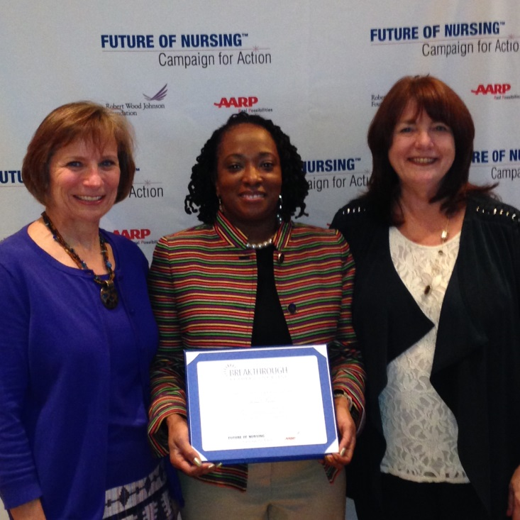
Wisconsin - National Award Winner!
Josie Veal, PhD, RN
Associate Dean - School of Health Sciences
Milwaukee Area Technical College
~National Breakthrough Leader in Nursing~

Slide 79
Thank YOU for Taking the LEAD!
LEAD Donor:
Katharyn May, PhD, RN, FAAN – Dean, UW Madison SON
LEAD Organizations:
Administrators of Nursing Education in Wisconsin (ANEW)
Aurora Health Care
Bellin Health Care Systems
Faye McBeath Foundation
Meriter-UnityPoint Health
Rural Wisconsin Health Cooperative
Wisconsin Nurses Association & Nurses Foundation of WI

Slide 80
Contact Info
Judith M. Hansen, MS, BSN, RN
1921 East Hartford Ave. PO Box 413
Milwaukee, WI 53201-0413
414-801-NURS (6877)
judi@wicenterfornursing.org
www.wicenterfornursing.org
‘Like us’ on FaceBook!

