Slide 1

The Role of the APRN on the Provider Team Developing New, Innovative Models of Care
August 11, 2014
For live audio, you must use your phone and dial (866) 513-4976; passcode: 6875187.

Slide 2


Susan B. Hassmiller, PhD, RN, FAAN
RWJF Senior Adviser for Nursing; Director, Future of Nursing: Campaign for Action
www.campaignforaction.org/webinars
Notes:
Sue Hassmiller
Good afternoon and welcome. I want to thank all of you for taking time to join us. As you know, the Campaign for Action focuses on making policy changes at the state and national levels. Today, we’re going to focus on an initiative being used to promote effective polices at the institutional level.
Today’s webinar will examine an innovative database being used to help hospitals and health systems develop new models of care. These models promote the role of the APRN on the Provider Team by using data at the institutional level.
On the webinar with us today, we are happy to have representatives from the Center for Advancing Provider Practices, known as CAP 2, which is a national collaboration between the University HealthSystem Consortium and the Metropolitan Chicago Healthcare Council. They designed a database to maximize the effectiveness and efficiency of provider teams. This tool provides organizations with the resources and information needed to assess and manage APRNs within provider teams and remove any barriers to scope of practice within an organization.
Additionally, CAP 2 see this as a win-win opportunity. They would like your help to identify hospitals and health systems to join their database. In return for you successfully connecting them with hospitals, they will reward you for your efforts. At the end of the presentation, CAP 2 will make a general offer to Action Coalitions to be involved with recruiting hospitals for a financial reward and for access to data. I do need to point out that this is the only database of its kind that we are aware of. Should we be informed of others, we will make you aware of those databases as well. RWJF, AARP, nor the Campaign for Action are officially endorsing this database; although, it is consistent with the Campaign’s efforts.
Before I turn this over, I want to mention that we are recording today’s webinar, so if you miss a section or would like to pass it on to a colleague, you can find the recording by going to www.campaignforaction.org/webinars.
We will be taking questions over the phone at the end of the webinar. Winifred Quinn, Director of Advocacy and Consumer Affairs at the Center to Champion Nursing in America is on the line with us and will help facilitate Q&A. But you can also type questions throughout the webinar using the chat function. Just be sure to send your question to “everyone”.

Slide 3

TITLE OF PRESENTATION LORUM IPSUM DOLOR
The Role of the APRN on the Provider Team Developing New, Innovative Models of Care
Center for Advancing Provider Practices (CAP2)
Overview and Demonstration
August 11, 2014
08/23/13
Notes:
Sue Hassmiller
Let me know turn this over Trish Anen, Vice President of Clinical Services at the Metropolitan Chicago Healthcare Council.

Slide 4
IOM Recommendations
Remove scope-of-practice barriers. Advanced practice registered nurses should be able to practice to the full extent of their education and training
Expand opportunities for nurses to lead and diffuse collaborative improvement efforts
Implement nurse residency programs
Increase the proportion of nurses with a baccalaureate degree to 80 percent by 2020
Double the number of nurses with a doctorate by 2020
Ensure that nurses engage in lifelong learning
Prepare and enable nurse to lead change to advance health
Build an infrastructure for the collective and analysis of interprofessional health care workforce data
The Future of Nursing Leading Change, Advancing Health Report Recommendations. Institute of Medicine of the National Academies. Retrieved from: http://www.iom.edu/~/media/Files/Report%20Files/2010/The-Future-of-Nursing/Future%20of%20Nursing%202010%20Recommendations.pdf

Slide 5
State Action Coalitions
The driving force of the Campaign for Action at the local and state levels, forming a strong, connected grassroots network of diverse stakeholders working to transform health care through nursing.
Center for Advancing Provider Practices (CAP2)
One of a kind resource to drive change at the organization level to support APRN practice to the full extent of their education and license.

Slide 6
CAP2 History
MCHC work began in 2009 driven by CNO/CMO request — Hiring more APRNs and need to better understand roles, regulations and infrastructure to support
Partnered with UHC in 2012 — UHC receiving same request from their members
Initial survey results in static report— participants requested ability to access data, benchmarks, and toolkits in real time
Recognized as Best Practice by the Joint Commission and Advisory Board
Developed first of its kind, web-based, interactive management tool
November 2009- First survey completed
Evolving Models of Care
Patients Entering Health System

Slide 7

Introducing CAP2
Goal: Top of license for all care team members.
Assess: Utilization of APRN/PAs
Manage: Infrastructure to support APRN/PA practice
Optimize: All APRN/PA activities at medical level of care
Standardize: Best practices for APRN/PAs
Notes:
Goal: Assist providers and management in all settings optimize the role of the Advanced Practice Registered Nurse (APRN) and Physician Assistant (PA) on the provider team
Interactive website encompassing:
Organizational assessments
Benchmarking reports
Resource toolkits
Management tool to boost health care leaders’ knowledge and decision making abilities
Reduce administrative costs through standardized processes, improved employee engagement and productivity

Slide 8

CAP2 Database
Data represents:
125 organizations (hospitals, healthcare systems, academic medical centers)
Over 19,000 APRNs and PAs
25 different states
50 different specialty areas
And growing
Notes:
At this point we are able to assess and compare APRN and PA practices and privileges for over 125 organizations in 25 states. As we sign up more participants we will add to our current data on more than 19,000 APRNs and PAs. The more data we collect we can improve processes and create additional resources as needed.

Slide 9


CAP2 Solutions
Organizational Assessments
Benchmarking reports
organization, system, state, national, and defined compare groups
Multiple resources and toolkits
National workgroups
National listserv updates
Ambulatory assessment and reports (November 2014)

Slide 10
Assess Utilization
 |  | CAP2 Database |  |  | Health Care System
Specialty | Practitioner | # Hospitals | # Practitioners | Avg / Hospital | # Hospitals | # Practitioners | Avg / Hospital
Internal Medicine | APRN | 94 | 924 | 9.83 | 2 | 16 | 8.00
Anesthesia | APRN | 113 | 3640 | 32.21 | 3 | 20 | 6.67
Cardiology | APRN | 90 | 692 | 7.69 | 2 | 8 | 4.00
Education | APRN | 38 | 141 | 3.71 | 1 | 4 | 4.00
Intensive Care | APRN | 75 | 666 | 8.88 | 3 | 6 | 2.00
Emergency Medicine | APRN | 88 | 491 | 5.58 | 4 | 8 | 2.00
Hematology/Oncology/Bone Marrow | APRN | 75 | 885 | 11.80 | 1 | 1 | 1.00
Cardiovascular Surgery | APRN | 67 | 330 | 4.93 | 2 | 2 | 1.00
Endocrinology | APRN | 53 | 144 | 2.72 | 1 | 1 | 1.00
Neurology | APRN | 73 | 193 | 2.64 | 1 | 1 | 1.00
Gastroenterology/ Endoscopy/Hepatology | APRN | 61 | 159 | 2.61 | 2 | 2 | 1.00
Geriatrics | APRN | 48 | 105 | 2.19 | 3 | 3 | 1.00
Breast Health | APRN | 33 | 64 | 1.94 | 1 | 1 | 1.00
Infectious Disease | APRN | 47 | 83 | 1.77 | 1 | 1 | 1.00
Electrophysiology | APRN | 32 | 43 | 1.34 | 1 | 1 | 1.00
Neonatal | APRN | 60 | 565 | 9.42 | 0 | 0 | 0.00
Family Medicine | APRN | 78 | 449 | 5.76 | 0 | 0 | 0.00
Neurosurgery | APRN | 73 | 315 | 4.32 | 1 | 0 | 0.00
Colon/Rectal Surgery | APRN | 25 | 48 | 1.92 | 0 | 0 | 0.00
Allergy/Immunology | APRN | 25 | 45 | 1.80 | 0 | 0 | 0.00
Genetics, Birth Defects & Metabolism | APRN | 13 | 22 | 1.69 | 0 | 0 | 0.00
Bariatric Surgery | APRN | 30 | 40 | 1.33 | 0 | 0 | 0.00
Dermatology | APRN | 25 | 31 | 1.24 | 0 | 0 | 0.00
Burns | APRN | 24 | 21 | 0.88 | 0 | 0 | 0.00
Inflammatory Bowel Disease | APRN | 18 | 14 | 0.78 | 0 | 0 | 0.00

Slide 11
Health Care System
Identify Variation
Hospital A
Hospital B
Hospital C
Hospital D
Hospital E
Hospital F
Hospital G
Hospital H
Hospital I
APRN Core Privilege List | CAP2 Database
 | # Hospitals Privileging APRNs | % of Total (n*=112)
Write admission orders | 77 | 69%
Write discharge orders | 85 | 76%
Write transfer orders | 74 | 66%
Obtain history and physical | 101 | 90%
Order and interpret diagnostic testing and therapeutic modalities | 103 | 92%
Order and perform referrals and consults | 90 | 80%
Order blood and blood products | 82 | 73%
Order and manage conscious sedation | 95 | 85%
Order inpatient non-scheduled medications | 83 | 74%
Order inpatient scheduled (II-V) medications | 39 | 35%
Order topical anesthesia | 81 | 72%
Prescribe outpatient non-scheduled medications | 85 | 76%
Prescribe outpatient scheduled (II-V) medications | 73 | 65%
Incision and drainage with or without packing | 74 | 66%
Other | 12 | 11%
N | Y | Y | N | Y | N | Y | N | N
N | Y | Y | N | Y | Y | Y | N | N
Y | Y | Y | N | N | Y | Y | N | N
Y | Y | Y | N | Y | Y | Y | N | N
Y | Y | Y | N | Y | N | Y | Y | N
Y | Y | N | N | N | Y | Y | Y | N
Y | Y | Y | N | N | N | Y | N | N
Y | Y | Y | N | Y | N | Y | Y | N
Y | Y | N | N | Y | N | Y | N | N
N | Y | Y | N | N | N | Y | Y | N
N | Y | Y | N | N | N | Y | Y | N
Y | Y | Y | N | N | N | Y | Y | N
Y | Y | N | N | N | N | N | N | N
Y | Y | N | N | Y | N | Y | Y | N
N | Y | N | N | Y | N | Y | N | N
Notes:
CAP2 team pulled a report assessing prevalence of APRN and PA core privileges across the system.
As with previous case study, CAP2 data showed wide variation across the system
Report became the starting point for discussion among CMOs, medical group leaders, department chair-people, and CNOs about why there is variation and how to diminish it.

Slide 12
Health Care System
Achieve Optimization – Top of License
Hospital A
Hospital B
Hospital C
Hospital D
Hospital E
Hospital F
Hospital G
Hospital H
Hospital I
APRN Core Privilege List | CAP2 Database
 | # Hospitals Privileging PAs | % of Total (n*=112)
Write admission orders | 77 | 69%
Write discharge orders | 85 | 76%
Write transfer orders | 74 | 66%
Obtain history and physical | 101 | 90%
Order and interpret diagnostic testing and therapeutic modalities | 103 | 92%
Order and perform referrals and consults | 90 | 80%
Order blood and blood products | 82 | 73%
Order inpatient non-schedule medications | 95 | 85%
Order inpatient schedule (II-V) medications | 83 | 74%
Order conscious sedation | 39 | 35%
Order topical anesthesia | 81 | 72%
Prescribes outpatient non-schedule medications | 85 | 76%
Prescribes outpatient schedule (II-V) medications | 73 | 65%
Incision and drainage with or without packing | 74 | 66%
Y | Y | Y | Y | Y | Y | Y | Y | Y
Y | Y | Y | Y | Y | Y | Y | Y | Y
Y | Y | Y | Y | Y | Y | Y | Y | Y
Y | Y | Y | Y | Y | Y | Y | Y | Y
Y | Y | Y | Y | Y | Y | Y | Y | Y
Y | Y | Y | Y | Y | Y | Y | Y | Y
Y | Y | Y | Y | Y | Y | Y | Y | Y
Y | Y | Y | Y | Y | Y | Y | Y | Y
Y | Y | Y | Y | Y | Y | Y | Y | Y
Y | Y | Y | Y | Y | Y | Y | Y | Y
Y | Y | Y | Y | Y | Y | Y | Y | Y
Y | Y | Y | Y | Y | Y | Y | Y | Y
Y | Y | Y | Y | Y | Y | Y | Y | Y
Y | Y | Y | Y | Y | Y | Y | Y | Y
Notes:
CAP2 team pulled a report assessing prevalence of APRN and PA core privileges across the system.
As with previous case study, CAP2 data showed wide variation across the system
Report became the starting point for discussion among CMOs, medical group leaders, department chair-people, and CNOs about why there is variation and how to diminish it.

Slide 13
Identify Variation – Specialty Privileges
Specialty |  |  | Academic Medical Centers |  | Northwest General Hospital | Suburban General Hospital | Urban City Hospital | Western County General
Specialty | Privilege | Practitioner | # Hospitals | % of Total | Privilege | Privilege | Privilege | Privilege
Emergency Medicine | Anterior nasal cautery | APRN | 23 | 43.40% | Y | N | N | Y
Emergency Medicine | Anterior nasal pack epistaxis | APRN | 28 | 52.83% | Y | N | Y | Y
Emergency Medicine | Arterial line insertion and removal | APRN | 13 | 24.53% | Y | N | N | Y
Emergency Medicine | Arterial puncture | APRN | 20 | 37.74% | Y | N | N | Y
Emergency Medicine | Athrocentesis | APRN | 12 | 22.64% | N | N | N | Y
Emergency Medicine | Central line insertion and removal | APRN | 13 | 24.53% | Y | N | N | Y
Emergency Medicine | Digital block | APRN | 27 | 50.94% | Y | N | Y | N
Emergency Medicine | Foreign object removal (eyelid) | APRN | 27 | 50.94% | N | N | N | Y
Emergency Medicine | G tubes, j tubes, small bowel tubes and cecostomy tubes insertion and removal | APRN | 12 | 22.64% | N | N | N | Y
Emergency Medicine | Gynecological exams, including Pap smears | APRN | 26 | 49.06% | Y | N | N | N
Emergency Medicine | Immobilization/splinting/reduction of simple fractures | APRN | 33 | 62.26% | Y | N | Y | Y
Emergency Medicine | Intraosseous needle insertion | APRN | 17 | 32.08% | Y | N | N | Y
Emergency Medicine | Joint Aspiration | APRN | 21 | 39.62% | N | N | N | Y

Slide 14

Remember…
Laws and regulations can be changed at the national and state level, but privileges are granted at the organizational level.
CAP2 data illuminates variation (barriers) and can drive optimization (top of license).

Slide 15


RN Activities Not Requiring Privileges
Frequently requested by APRNs
Not at the medical level of care
Already within RN scope of practice
“Would a physician ever ask for these privileges?”

Slide 16
CAP2 Solution
Activity | CAP2 Database | Illinois
Application & removal of casts, braces, or splints | 46 % | 33%
Clinical breast exam | 18% | 8%
Compression wrap for venous disease | 14% | 8%
Conduct nursing research and participate in interdisciplinary research | 21% | 25%
Conduct preventative screening procedures | 24% | 19%
Develop and implement a client education plan | 25% | 27%
Drain management | 28% | 21%
Initial care of newborn and assessment | 28% | 19%
Initiate ACLS to include defibrillation/cardioversion | 30% | 25%
Initiate BLS (CPR) | 30% | 21%
Initiate Neonatal ACLS | 26% | 17%
Performs waived tests (rapid strep, urine dip, blood glucose, etc.) | 18% | 17%
Placement of synthetic or biological dressings | 14% | 8%
Removal of casts | 34% | 23%
Removal of pleural chest tube | 28% | 21%
Removal of venous access | 24% | 19%
Update & record changes in health status | 32% | 33%

Slide 17
CAP2 Available Resources
The Role of the ARPN and PA
Billing and Reimbursement
Credentialing and Privileging
Competency Assessment
The Role of the ARPN and PA
Human Resources
Credentialing Checklist
Core Privilege List
Specialty Privilege Lists
Process for Adding New Privileges
Process to Expand Specialty Privileges
The Role of the APRN and PA: A Primer Presentation
APRN and PA Certification Lists
Annotated Bibliography of APRN and PA Articles
APRN and PA FAQ Websites
Sample APRN Job Description
Sample PA Job Description
Position-Specific Requirements Checklist
Job Posting Locations
Recruitment Process Recommendations
Orientation Checklist
Hiring Process Checklist
Interview Process Recommendations
Billing and Reimbursement Checklist
Billing and Reimbursement FAQs
Competency Assessment FAQs
Competency Assessment Report
Direct Observation Review Form for Focused Review
Documentation Review Form for Discharge Notes
Documentation Review Form for H&P, Admission, and Progress Notes
General Peer Review Form
Competency Assessment Flowchart – FPPE for Possible Competency or Performance Issue
Competency Assessment Flowchart – FPPE Process
Competency Assessment Flowchart – OPPE Process
Competency Assessment Process Summary
Human Resources
Credentialing and Privileging
Competency Assessment
Billing and Reimbursement

Slide 18
CAP2 DEMONSTRATION

Slide 19
CAP2 CASE STUDIES

Slide 20

CAP2 Case Study
Challenge: Organization wanted to hire an APRN into psychiatry to support behavioral health patients and needed to know the prevalence of this type of role for a medical executive committee meeting…the next day.

Slide 21
CAP2 Solution
Specialty |  | CAP2 Database |  |  | General Hospital Healthcare
Specialty | Practitioner | # Hospitals | # Practitioners | Avg / Hospital | # Hospitals | # Practitioners | Avg / Hospital
Nurse Midwives | APRN | 69 | 485 | 7.03 | 2 | 6 | 3.00
Obstetrics & Gynecology/Women's Health | APRN | 85 | 468 | 5.51 | 4 | 15 | 3.75
Occupational Health | APRN | 43 | 77 | 1.79 | 0 | 0 | 0.00
Ophthalmology | APRN | 7 | 8 | 1.14 | 2 | 4 | 2.00
Orthopedics | APRN | 69 | 254 | 3.68 | 0 | 0 | 0.00
Otolaryngology | APRN | 37 | 79 | 2.14 | 1 | 1 | 1.00
Pain management, Acute or Chronic | APRN | 55 | 108 | 1.96 | 0 | 0 | 0.00
Palliative Care | APRN | 73 | 190 | 2.60 | 1 | 1 | 1.00
Pediatrics (General) | APRN | 61 | 374 | 6.13 | 1 | 2 | 2.00
Physical Medicine & Rehabilitation | APRN | 41 | 82 | 2.00 | 1 | 1 | 1.00
Plastic & Reconstructive Surgery | APRN | 38 | 55 | 1.45 | 3 | 8 | 2.67
Prostate | APRN | 18 | 23 | 1.28 | 2 | 5 | 2.50
Psychiatry | APRN | 62 | 234 | 3.77 | 1 | 2 | 2.00
Pulmonary | APRN | 68 | 144 | 2.12 | 2 | 4 | 2.00
Radiology (General), nuclear, Interventional | APRN | 49 | 113 | 2.31 | 0 | 0 | 0.00
Renal/Nephrology | APRN | 47 | 117 | 2.49 | 3 | 6 | 2.00
Rheumatology | APRN | 25 | 35 | 1.40 | 0 | 0 | 0.00
Surgery (General) | APRN | 77 | 366 | 4.75 | 3 | 10 | 3.33
Transplant (Surgery) | APRN | 38 | 142 | 3.74 | 0 | 0 | 0.00
Transport | APRN | 8 | 8 | 1.00 | 1 | 3 | 3.00
Urogynecology | APRN | 33 | 32 | 0.97 | 0 | 0 | 0.00
Urology | APRN | 63 | 162 | 2.57 | 1 | 2 | 2.00
Vascular Surgery | APRN | 50 | 78 | 1.56 | 1 | 1 | 1.00
Wound/Ostomy | APRN | 48 | 52 | 1.08 | 1 | 1 | 1.00

Slide 22
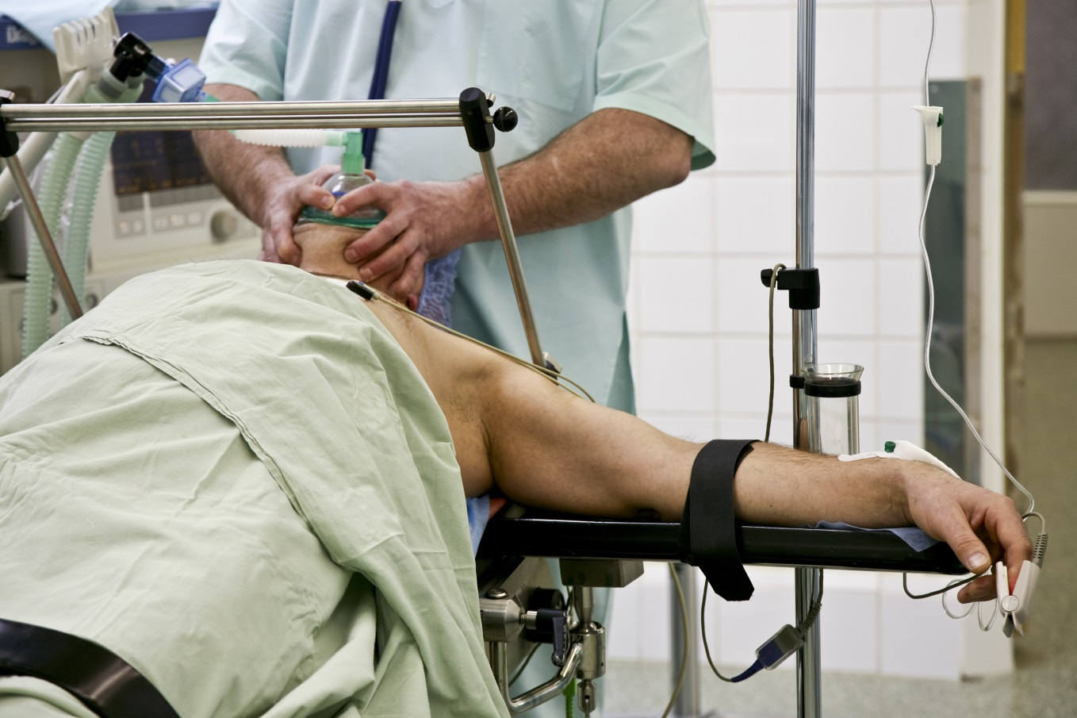
CAP2 Case Study
Challenge: Organization concerned about lack of anesthesia coverage across the system

Slide 23
CAP2 Solution
Specialty-Anesthesia |  | CAP2 Database |  | State |  | General Hospital Healthcare |  | Western County General | Northwest General Hospital | Suburban General Hospital | Urban City Hospital
Privilege | Practitioner | # Hospitals | % of Total | # Hospitals | % of Total | # Hospitals | % of Total | Privilege | Privilege | Privilege | Privilege
Airway management techniques | APRN | 93 | 74.40% | 49 | 73.13% | 3 | 75.00% | N | Y | Y | Y
Appropriate invasive monitoring modalities selection, application and insertion | APRN | 84 | 67.20% | 40 | 59.70% | 1 | 25.00% | Y | N | N | Y
Arterial line insertion and removal | APRN | 68 | 54.40% | 28 | 41.79% | 1 | 25.00% | N | N | N | Y
Central line insertion and removal | APRN | 61 | 48.80% | 26 | 38.81% | 2 | 50.00% | N | Y | N | Y
Emergency/ancillary drugs and fluids to maintain physiological homeostasis and to prevent or treat emergencies during the preanesthesia period administration | APRN | 83 | 66.40% | 47 | 70.15% | 3 | 75.00% | N | Y | Y | Y
General anesthesia and adjuvant drugs administration | APRN | 90 | 72.00% | 49 | 73.13% | 2 | 50.00% | N | Y | N | Y
General anesthesia or monitored sedation, regional anesthesia administration and monitoring | APRN | 93 | 74.40% | 50 | 74.63% | 3 | 75.00% | N | Y | Y | Y
Indwelling epidural catheters insertion, reposition and removal | APRN | 65 | 52.00% | 34 | 50.75% | 2 | 50.00% | Y | Y | N | Y
Mechanical ventilation/oxygen therapy | APRN | 78 | 62.40% | 40 | 59.70% | 3 | 75.00% | N | Y | Y | Y
Moderate/procedural sedation | APRN | 84 | 67.20% | 41 | 61.19% | 1 | 25.00% | N | N | N | Y
Monitor anesthesia care and patient operated under nerve block | APRN | 88 | 70.40% | 47 | 70.15% | 3 | 75.00% | N | Y | Y | Y
Pulmonary artery catheters placement | APRN | 34 | 27.20% | 12 | 17.91% | 1 | 25.00% | N | N | N | Y
Radial arterial lines insertion and removal | APRN | 56 | 44.80% | 26 | 38.81% | 2 | 50.00% | N | Y | N | Y
Regional anesthesia techniques | APRN | 74 | 59.20% | 40 | 59.70% | 1 | 25.00% | Y | N | N | Y
TEE probe under the direct supervision of an anesthesiologist insertion and manipulation | APRN | 64 | 51.20% | 32 | 47.76% | 2 | 50.00% | N | Y | N | Y
Showed significant variation in utilization of CRNAs throughout the system; CNO identified opportunity to support anesthesia gaps with CRNAs.

Slide 24

CAP2 Case Study
Challenge: System CEO committed to having all providers working to ‘top of their license’

Slide 25
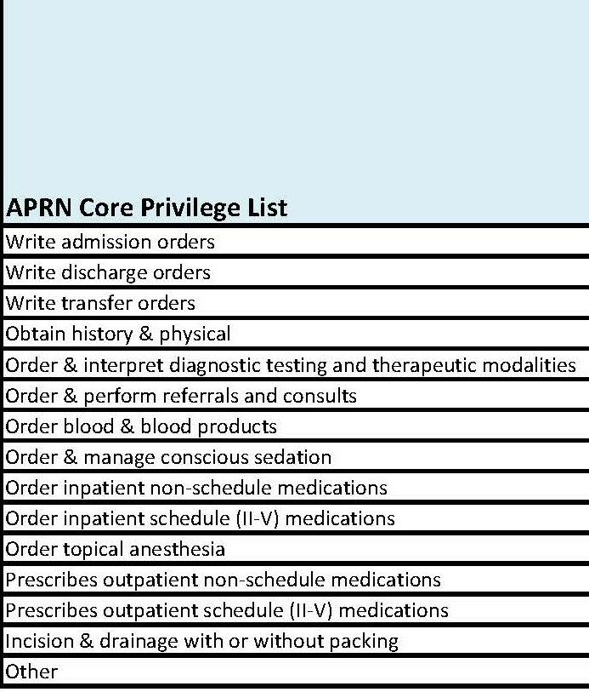
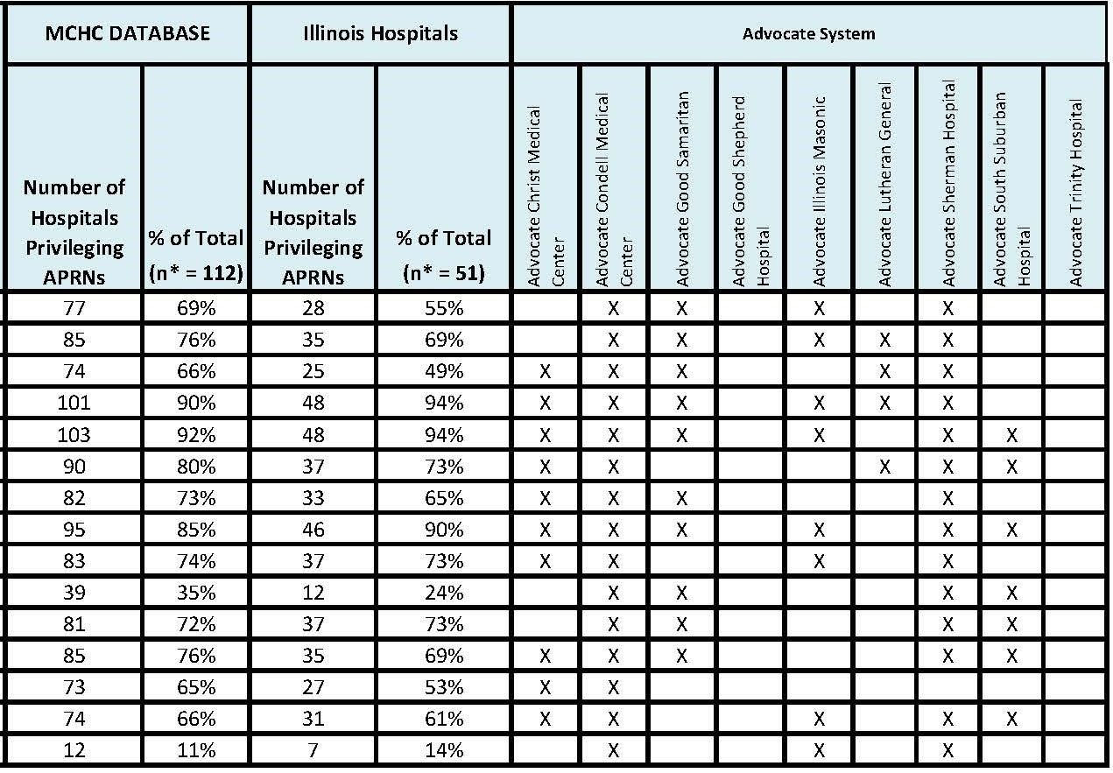
CAP2 Solution
Health System
Hospital A
Hospital B
Hospital C
Hospital D
Hospital E
Hospital F
Hospital G
Hospital H
Hospital I
Chartered system wide team to reduce variation, standardize model of care, build infrastructure to support top of license practice- members include CMOs, CNOs, HR & Credentialing executives, and practicing APRNs and PAs

Slide 26

CAP2 Resources
Used to develop a consistent approach to:
Models of Care
Credentialing and Privileging Process, Application and Specialty Privilege Lists
Job Descriptions
Hiring Process
Annual Performance Review Process and Form
Orientation/Onboarding
Competency Assessment Process and Forms

Slide 27

CAP2 Case Study
Challenge: In February, 2014, two bills proposed in Illinois legislature — one to limit administration of conscious sedation to only physicians, and the other to limit the use of fluoroscopy to only physicians. Illinois Hospital Association asked for data and stories of how this would impact APRN and PA practice.

Slide 28
CAP2 Solution
Privilege Report - Sedation |  |  | Illinois |  | Database
Specialty Area | Privilege | Practitioner | # Hospitals | % of Total | # Hospitals | % of Total
Core Privilege | Order conscious sedation | APRN | 45 | 70.31% | 93 | 74.40%
Core Privilege | Order conscious sedation | PA | 38 | 59.38% | 84 | 67.20%
Anesthesia | General anesthesia or monitored sedation, regional anesthesia administration and monitoring | APRN | 47 | 73.44% | 93 | 74.40%
Anesthesia | Moderate/procedural sedation | APRN | 40 | 62.50% | 84 | 67.20%
Anesthesia | General anesthesia or monitored sedation, regional anesthesia administration and monitoring | PA | 0 | 0.00% | 5 | 4.00%
Anesthesia | Moderate/procedural sedation | PA | 0 | 0.00% | 11 | 8.80%
Emergency Medicine | Moderate/procedural sedation | APRN | 7 | 10.94% | 21 | 16.80%
Emergency Medicine | Moderate/procedural sedation | PA | 8 | 12.50% | 24 | 19.20%
Neurosurgery | Moderate/procedural sedation | APRN | 2 | 3.12% | 15 | 12.00%
Neurosurgery | Sedation administration for invasive or bedside surgical procedures | APRN | 1 | 1.56% | 4 | 3.20%
Neurosurgery | Moderate/procedural sedation | PA | 1 | 1.56% | 9 | 7.20%
Neurosurgery | Sedation administration for invasive or bedside surgical procedures | PA | 1 | 1.56% | 4 | 3.20%
Plastic and Reconstructive Surgery | Conscious sedation | APRN | 2 | 3.12% | 4 | 3.20%
Plastic and Reconstructive Surgery | Conscious sedation | PA | 0 | 0.00% | 3 | 2.40%
This data was sent to the Illinois Hospital Association within 2 hours of request.

Slide 29

CAP2 Case Study
Challenge: Organization could not hire enough intensivists to provide 24/7 coverage for new ‘closed’ ICU model

Slide 30
CAP2 Solution
“I was intrigued by the breadth and the success of APRN/PA activities garnered from the database. It was a crucial factor in moving our hospital system toward a new closed ICU model of care that integrates APRN’s and Intensivists for 24/7 face to face care. Data for the first 3 months of operation looks excellent with improvement in mortality, LOS and cost along with reduced readmissions”
- Dr. Zbigniew Lorenc, Vice President, Medical Affairs
Centegra Health System

Slide 31

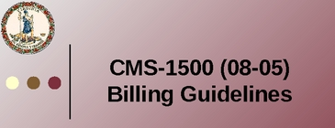
CAP2 Case Study
Challenge: Service line director questioned whether an APRN or PA can bill for inpatient services

Slide 32
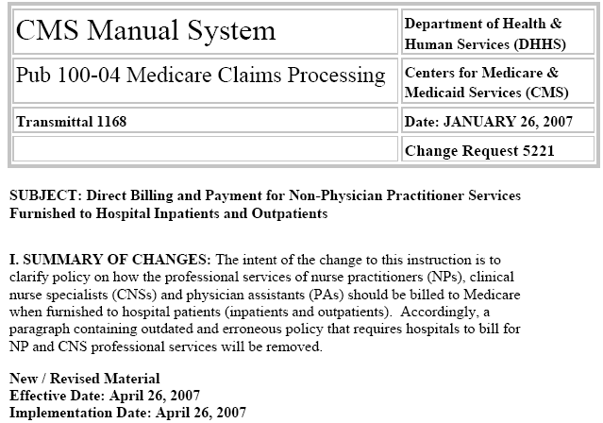
CAP2 Solution
These CMS guidelines were emailed immediately to organization
Reimbursement for APRN Services
Health Management Associates

Slide 33
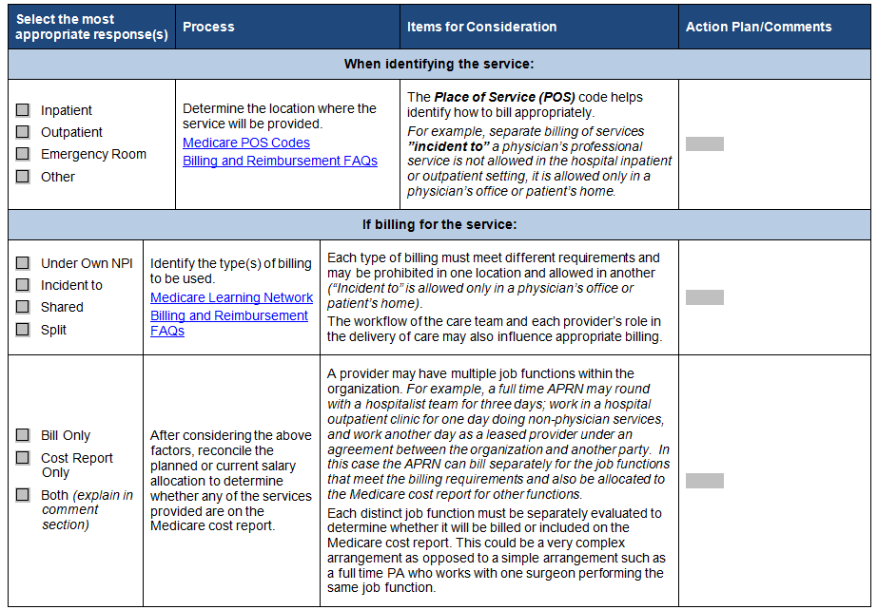
Another CAP2 Solution
One organization captured over $200,000 in revenue by auditing current practices.

Slide 34

CAP2 Case Study
Challenge: Organization considering adding Advanced Practitioner to Medical Staff Credentialing Committee — needed prevalence and role description.

Slide 35
CAP2 Solution
“MCHC creates strength in numbers through the data they collect. They've given me a resource to work with our Chief Nurse Executives, Medical Staff Office, Allied Health Professionals, Credentials Committee and the Governing Council of Advocate Medical Group.”
- Lise Hauser, APN-PA Governing Council Representative
Advocate Medical Group
“My organization is changing its medical staff bylaws...due to what we learned from the MCHC Database.”
- Michele Rubin, APN Executive Council Chair
University of Chicago Medical Center

Slide 36


CAP2 Case Study
Challenge: Organization received a finding during Joint Commission survey regarding effectiveness of their OPPE/FPPE for APRNs and PAs required to develop a written action plan within 45 days. Joint Commission suggested they call us.

Slide 37
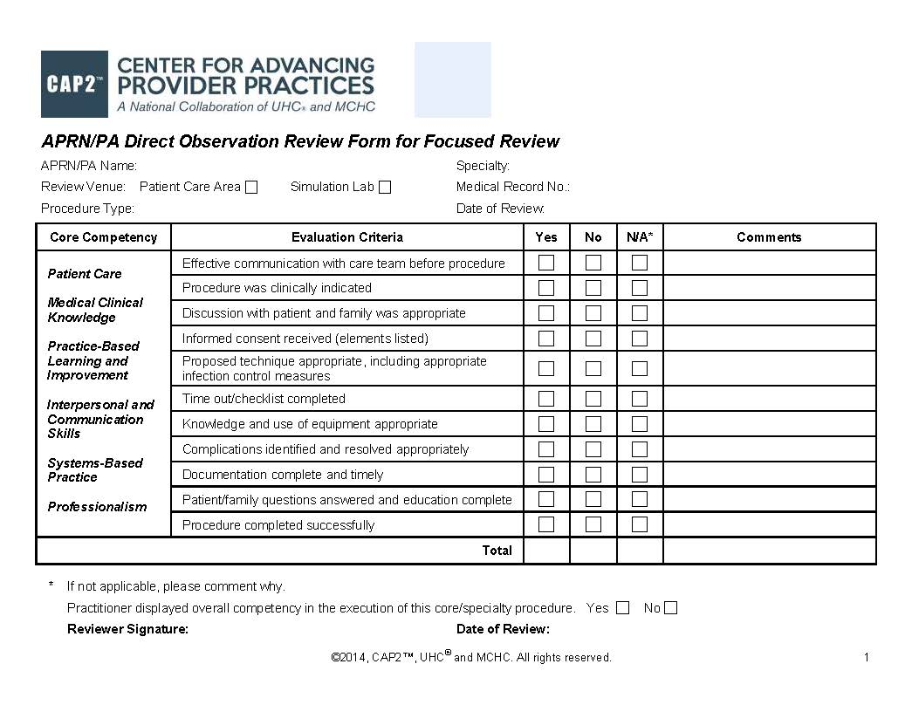
CAP2 Solution

Slide 38

Cap2 Emerging Trends

Slide 39
Emerging Trend: APRN/PA Coordinator
40% of academic medical centers have an identified leader who coordinates APRN/PAs; we are also seeing this role emerge in healthcare systems.
Illinois 2013
Academic Medical Centers

Slide 40
Interdisciplinary Teams
57% of academic medical center participants include APRNs and PAs on their hospitalist team and 70% on their intensivist team.
Illinois 2013
Academic Medical Centers

Slide 41
APRN/PA Competency Review - Approaches

Slide 42
Role of the Chief Nursing Officer in the credentialing of APRN

Slide 43
CAP2 Support for Transition to Practice
Goal: To provide a model and supporting resources to structure onboarding new APRNs and PAs
Current Resources:
Orientation materials in the toolkits
National workgroup - developing recommendations for a model and key resources

Slide 44

Structure of Transition to Practice Resources in CAP2
Each component has an overview, recommendations based on national practice, and associated resources
Model/Structure
Professional Role
Clinical Competencies
Economics

Slide 45

Ambulatory Survey Coming November 2014
Models of Care (primary care; medical and surgical specialties)
Advance Practice Leader
Onboarding/Orientation
Governance and committee involvement
Other practice settings
Patient type
Panel size/case load
Productivity expectations
Compensation practices
Reporting structures
Billing practices

Slide 46
Closing Thoughts
Goal: Top of license for all care team members.
Strategic Action Plan
Assess: Utilization of APRN/PAs
Manage: Infrastructure to support APRN/PA practice
Optimize: All APRN/PA activities at medical level of care
Standardize: Best practices for APRN/PAs
Result: High quality, cost-effective care for all patient populations.

Slide 47

State Action Coalition Partners
Ongoing discussions with State Action Coalitions
Illinois
Texas
NWONE in partnership with Washington and Oregon State Action coalitions
Idaho
California
Opportunity for Coalitions to partner with CAP2 for a potential revenue share

Slide 48
Questions
Molly Harper
mharper@mchc.com

Slide 49

Questions or Comments?
Press *1 on your telephone key pad to ask a question
OR
Use the “chat” feature to send “everyone” a question.
You can find the recording and additional webinar resources by going to: www.campaignforaction.org/webinars.
Notes:
Win Quinn
Facilitate Q&A.. Ask Operator to Open the phone lines.

Slide 50



Campaign Resources
Visit us on the web at www.campaignforaction.org
http://facebook.com/campaignforaction www.twitter.com/campaign4action
Notes:
Win Quinn
As was mentioned in the beginning, if you missed a section of the webinar or would like to pass it on to a colleague, you can find the recording and any additional webinar resources by going to www.campaignforaction.org/webinars.
Be sure to join the conversation via the Community at www.campaignforaction.org, follow us on twitter, join us on Facebook, and sign up for the Weekly Update, also on campaignforaction.org!

