Slide 1

NEXT GEN NCLEX
Monica J Harmon, MSN, MPH, RN

Slide 2

What’s The Weather Forecast?

Slide 3
Objectives
Introduce/Present Next Gen NCLEX
Clarify Next Gen NCLEX
Learn about additional NCSBN resources related to the exam, including further opportunities for involvement

Slide 4

What Have You Heard?
Has what you’ve heard impacted your teaching

Slide 5
‘If It Isn’t Broken, Why Fix It?’
The NCLEX measures the foundational knowledge and skills needed for safe nursing practice for entry-level nurses despite academic background.
Every three years, NCSBN conducts a practice analysis to evaluate the knowledge, skills, and abilities needed for entry-level practice & evaluate the validity of the test plan for the licensure examination.
Practice analyses have highlighted changes in healthcare (i.e., an increase in acutely ill clients, clinical judgment, delegation, & decision-making).
Nurses are responsible for a significant proportion of the judgments and decisions made in healthcare, and newly licensed nurses are required to make progressively more complex decisions about patients.

Slide 6
How Did We Get Here?
2009 - NCSBN reviewed several research reports and engaged in professional discussions with nursing experts on the importance of clinical judgment in nursing.
The report found that 50% of entry-level nurses were involved in practice errors, 65% of entry-level nurse errors were related to poor clinical decision-making & only 20% of employers were satisfied with the decision-making abilities of entry-level nurses.
2012-2014 – Two studies provided showed the importance of clinical judgment in entry-level nursing.
  Major findings → clinical judgment, problem-solving, critical thinking, professional communication, & active listening were the top five high-priority skills.
  Clinical judgment = problem-solving + critical thinking

Slide 7
How Did We Get Here?
2017 – RN Knowledge Survey
  Clinical judgment was rated between ‘important’ and ‘critically important’ by newly licensed RNs, RN educators, and RN supervisors & across the facility categories of hospitals, long-term care, community-based care, and other care settings.
2018 – LPN/LVN Practice Analysis
  The findings showed entry-level PN was expected to provide care using the nursing process framework and make the necessary clinical judgments within their scope of practice.

Slide 8
How Reliable Is Next Gen NCLEX?
NCSBN has conducted and continues to conduct multi-year studies to support the development of a Next Generation NCLEX (NGN).
Research studies analyze current items and document the validity of the items to measure clinical judgment.
Validity evidence includes:
  1) the extent to which clinical judgment can be measured,
  2) numerous item writing panels comprised of nurse faculty to write items aligned with the NCSBN Clinical Judgment Measurement Model (NCJMM), &
  3) nursing experts (nursing faculty, clinical educators, clinicians, and numerous committees made up of experienced nursing experts) reviewing items to ensure the

Slide 9
How Is Clinical Judgment Defined?
Based upon extensive literature reviews in nursing, decision theory, and testing.
The result was the assessment framework referred to as the NCSBN Clinical Judgment Measurement Model (NCJMM).
NCJMM is a framework designed for and specific to testing and should not be construed as a replacement for other evidence-based theories of nursing theory or practice.
The NCJMM does not compete with the Nursing Process or specific pedagogical or andragogical models around the teaching of clinical judgment.
NCJMM provides a systematic, evidence-based framework for measuring whether nurse licensure candidates demonstrate at least minimal competence with respect to clinical judgment and decision-making.

Slide 10
What’s Up With The New Exam?
The NCJMM can be applied to almost any clinical scenario, including topics such as legal rights and responsibilities, ethics, etc.
Research will continue on applying the model to all topics covered in the NCLEX test plan.
Research section began in July 2017.
Item development is being conducted internally.
NCSBN plans to provide information to test preparation and publishing companies later after our research has been validated and the test design has been determined.
The Next Generation NCLEX will become effective beginning April 1, 2023.

Slide 11
What’s Up With The New Exam?
Test rigor will not change the new exam.
The new exam will continue maintaining the high-level reliability and accuracy that is expected of the NCLEX
Continues standard of excellence in the regulation of nursing practice with a focus on public safety and health care needs.

Slide 12
For Educators
Educators can immediately begin incorporating the clinical judgment measurement model into their curriculum.
The model can be used in various nursing education settings, such as simulation labs, clinical rotation post-conference, and standard written exams.
The Spring 2019 Next Gen NCLEX Newsletter is a useful tool for developing clinical judgment assessments for students.
NCSBN has begun providing education to faculty.
Shameless Plug Alert → NCSBN encourages faculty to apply for item writing volunteer opportunities, including regular NCLEX-style item writing and NGN item writing panels.
Wide outreach to educators, students, and test preparation companies to ensure adequate preparation before any exam changes.
Educators can best prepare their students by keeping abreast of NGN updates on the NCSBN webpage (Subscribe to our Mailing List - Next Generation NCLEX | NCSBN) for informational updates.

Slide 13
Next Gen NCLEX Scoring
The scoring model for NGN will extend the current scoring model.
Currently, the NCLEX® items are dichotomous models → scored as either 'all correct' or 'all incorrect.’
The new NGN scoring models, called polytomous models, → allow partial scores of items with multiple points.
NGN stand-alone items are items that can be administered individually. They can be any of the new NGN response types (e.g., Drag and Drop, Multiple Response (MR), Select All That Apply (SATA), Highlight, etc.).
The new scoring methods allow for moving beyond the current scoring model that is based on candidates' responses being scored as 'all correct' or 'all incorrect.’ The new polytomous scoring methods will allow for the evaluation of partial knowledge.
The passing standard is determined through a panel of Nursing Subject Matter Experts (SMEs) to identify the score associated with a minimally competent candidate.
The scoring models do not affect the delineation of the passing standard.

Slide 14
How’s The Weather Now?

Slide 15
Next Steps
Session Two – Monday, March 13, 2023, from 9-10 AM EST
  Types of Test Items
  Test Item Development
Session Three – Monday, April 10, 2023, from 9-10 AM EST
  Develop Your Own Items

Slide 16
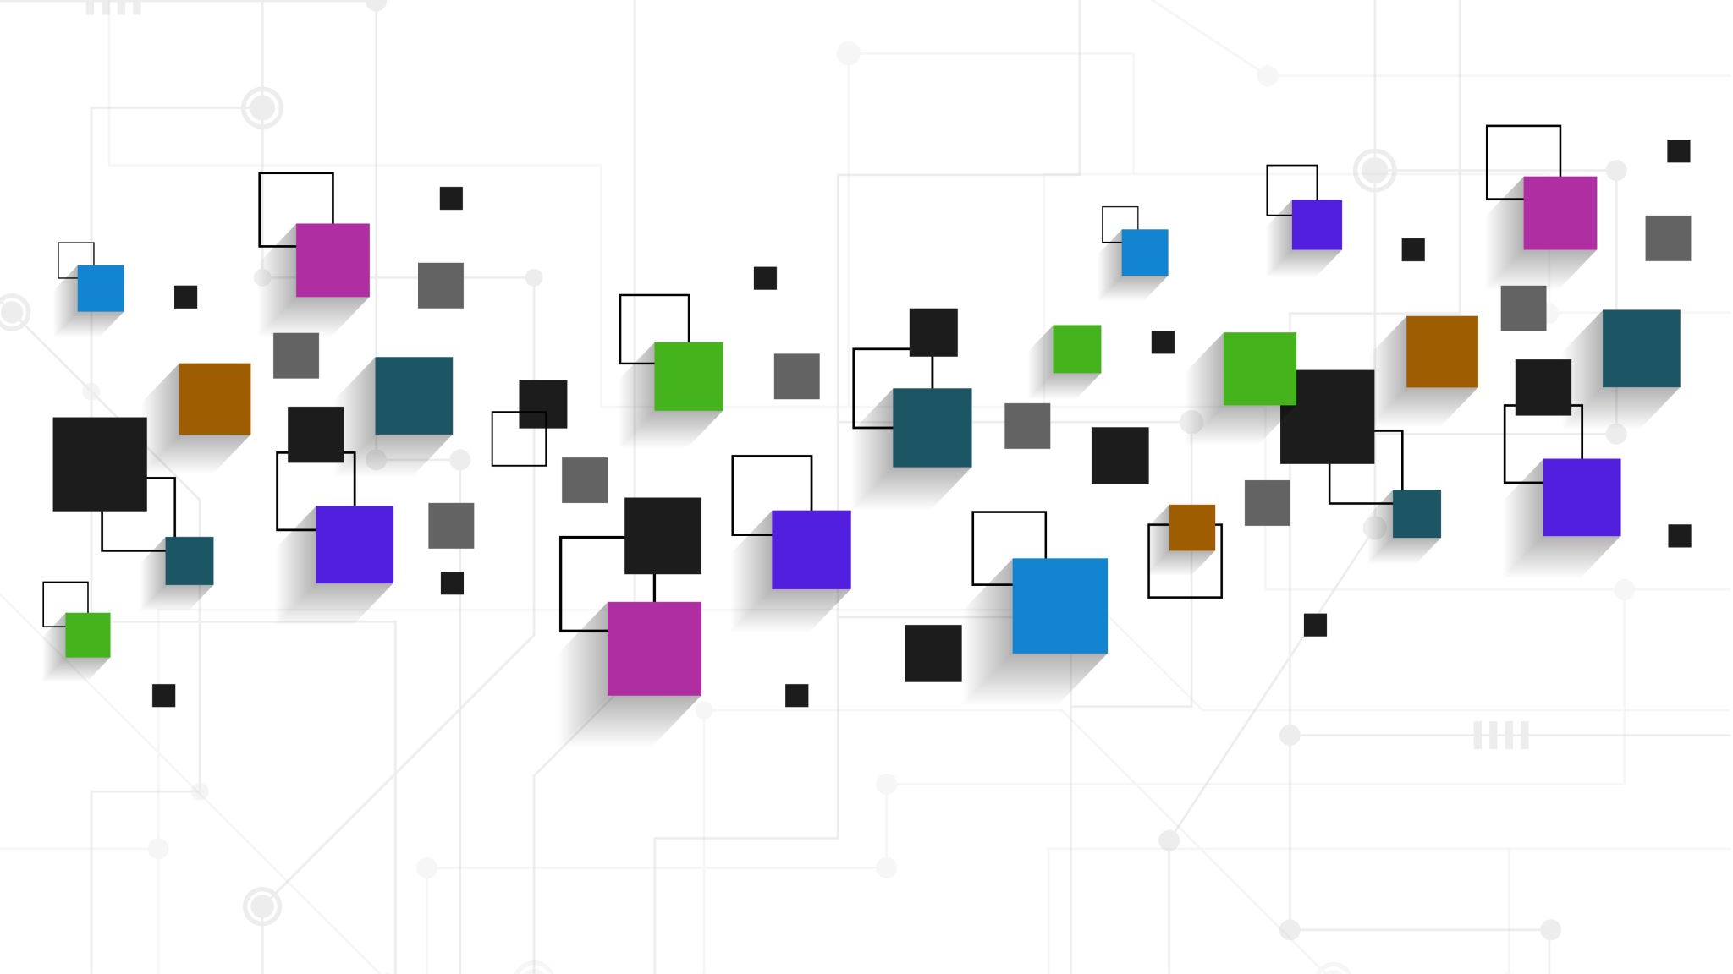
THANK YOU!!!
Monica Harmon, MSN, MPH, RN
mjh62@drexel.edu

