Slide 1

Writing HRSA GRANTS:
An Insider's View
Debra J. Barksdale
Audrey Snyder and
Wanda Williams
University of North Carolian Greensboro School of Nursing

Slide 2
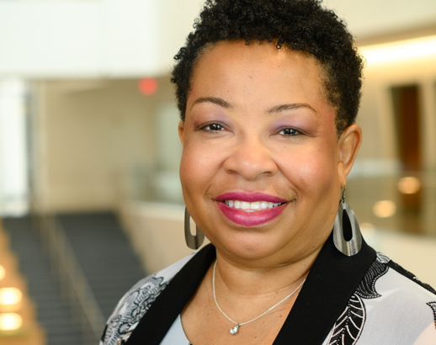
Meet Our Team
Debra J. Barksdale, PhD, FNP-BC, FAANP, ANEF, FAAN
Dean and Professor
President-Elect American Academy of Nursing

Slide 3
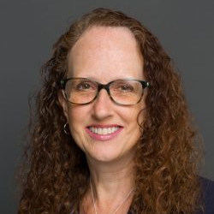
Audrey Snyder
PHD, RN, CCRN, CEN, ANCP-BC, FNP-BC, FAANP, FAEN, FAAN
Professor & Associate Dean for Community Engagement And Academic Partnerships

Slide 4
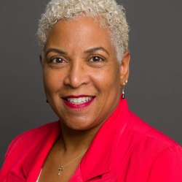
Wanda Williams
PHD, MSN, RN, WHNP-BC, CNE
Associate Professor,
Director of Advanced Nursing Programs
Department Chair For Advanced Nursing Education

Slide 5
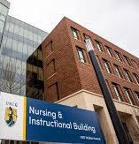
About UNC-G
Minority Serving Institution
Classified as R2 High Research Productivity
Not an Academic Health Sciences Center
SON has approximately 750 students
  Pre-licensure BSN
  RN to BSN
  MSN: FNP & Leadership
  DNP-AGPCNP, CRNA, & Post-MSN
  PhD
High percentage of 1st Generation

Slide 6
Goals
Share opportunities for HRSA grants
Describe specific HRSA Grants at UNCG
  LEAD: Maternal Child Health (Snyder)
  Minerva Mobile Health (Snyder)
  SET (Snyder)
  ANEW (Williams)
Present Tips for Writing HRSA grants
Discuss "common elements" in most HRSA Grants

Slide 7
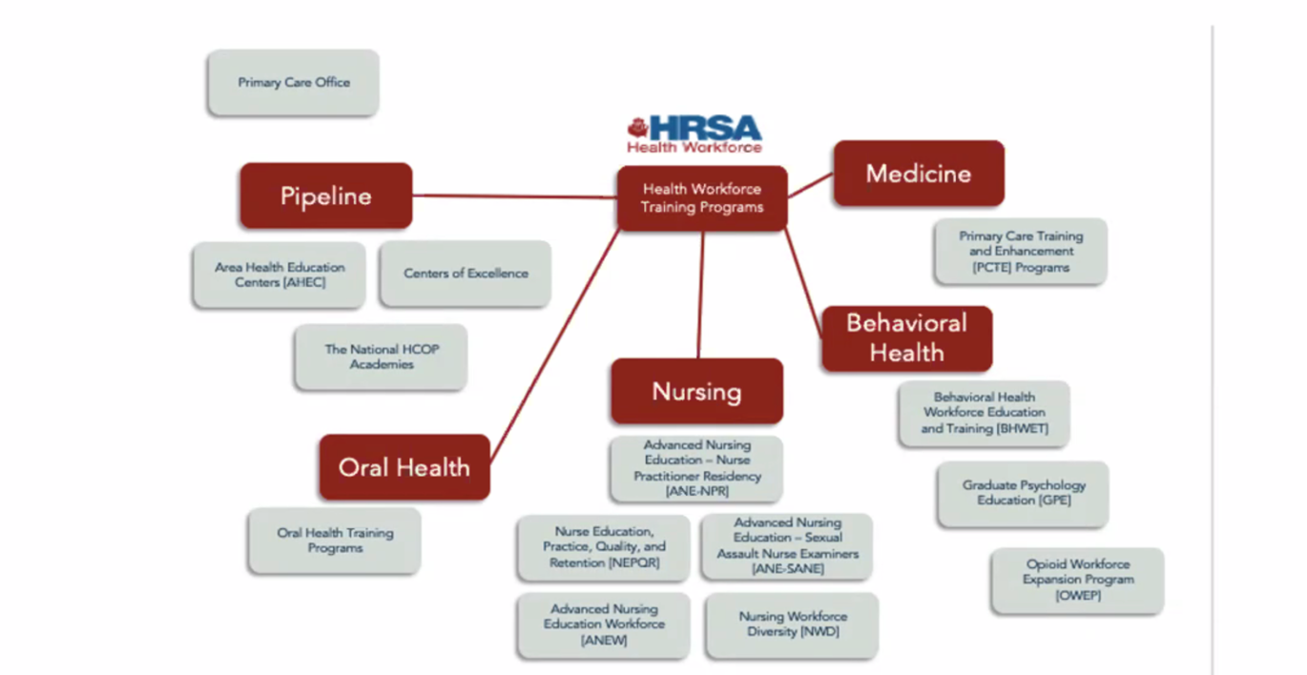

Slide 8
HRSA Grants Currently at UNCG
Health Workforce
  Nurse Faculty Loan Program For DNP & PhD Students (Letvak)
  Advanced Nursing Education Workforce (Williams)
  Scholarships for Disadvantaged Students (Institutional)
  Nurse Anesthetist Traineeships (Eaves)
  Nurse Education Practice Quality Retention (Snyder)
  Simulation Education Training (Snyder)
  Nurse Led Mobile Unit (Snyder)
  Maternal Child Health (Anders)
Almost All of Our Grants Provide Student Scholarship Support also.

Slide 9
HRSA Grants Submitted & Not Received: 2023
A different NEPQR Simulation Education Training (SET) (Draper)
LPN/LVN to BSN Education and Career Mobility Pathway Program (Eaves)

Slide 10


LEAD in MCH:
Leadership, Education, and Diversity in Maternal Child Health
Lisa Anders, PhD, RN, IBCLC
University of North Carolina Greensboro
School of Nursing

Slide 11

LEAD in MCH: A HRSA LEAP Program
  “Purpose of the LEAP Program is to promote the development of a diverse and representative public health and health care workforce by recruiting undergraduate students from underserved or underrepresented backgrounds into MCH public health and MCH-related health professions in order to improve levels of representation, reduce health disparities, and increase access to health care for vulnerable and underserved MCH populations, including those from racially/ethnically diverse backgrounds.”
“
Notes:
-6 Programs across the country
-Ours is the only nursing program

Slide 12







GOALS:
  Increase diversity of the MCH nursing workforce
  Recruit, retain, and prepare students from culturally diverse, underserved, and underrepresented backgrounds (CDUUB) to work with diverse populations
METHODS:
  High School Enrichment Activities
  Recruit and retain 10 undergraduate students from culturally diverse and underrepresented, underserved backgrounds per year into MCH nursing program
  Enhance existing BSN MCH curriculum to include MCH public health competencies
  Shadowing & Internship experiences
Notes:
Therefore, one of the goals of our program at UNCG is to partner with local high schools to provide enrichment activities to introduce racially diverse and/or socioeconomically disadvantaged students to careers in MCH, specifically nursing.
By looking upstream, we can potentially increase enrollment into UNCG and then nursing school.

Slide 13


Workforce Population
  ·2022 Race/Ethnicity of Students Enrolled in Entry-level Baccalaureate Nursing Programs
    White 56.1%
    Black/African American 12.7%
    Hispanic or Latino 16.1%
    Asian/Pacific Islander 10%
    American Indian 0.5%
    >2 races 4.1%
  Additionally, in higher-education, students from high-income backgrounds are represented disproportionately by an excess of 45 percentage points
(AACN, 2023; Kozhimannil et al., 2021)
Notes:
Like the rest of the MCH workforce, nursing lacks cultural, racial, and socioeconomic concordance with the population that we serve.
While enrollment in nursing school, including UNCG, is improving in the amount of racial and ethnic diversity, there is a need to increase enrollment and interest in nursing of people from diverse backgrounds.

Slide 14
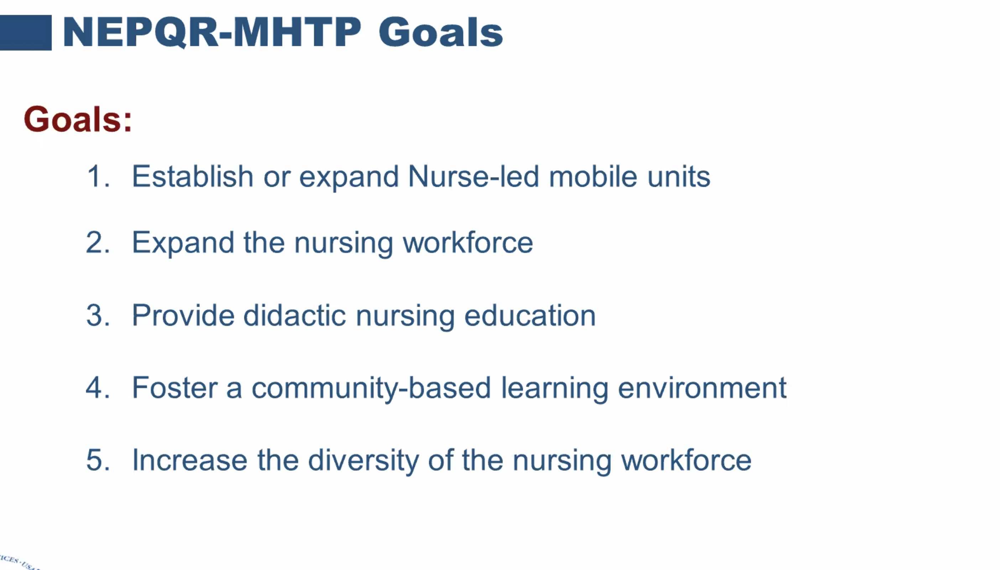

Slide 15



Nurse led mobile health units: Improving health outcomes with data science
Dr. Audrey Snyder
Assoc. Dean for Community Engagement & Academic Partnerships
A UNCG & Cone Health
Partnership
Notes:
Debbie

Slide 16
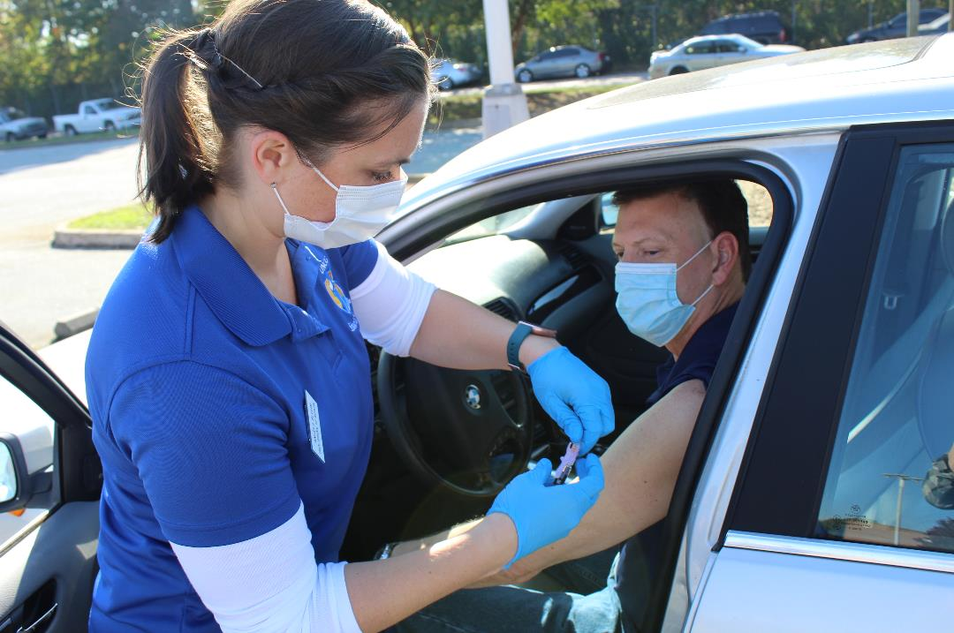
HRSA Mobile Health Grant:
One of 21 Recipients in the U.S.
Nurse led mobile health units: Improving health outcomes with data science
Amount: $3.7M awarded over a four-year period
Students: Graduate & undergraduate nurse student placement year round
Access: Mobile, Telehealth, Rural Clinics
Area: 6 Counties
Objective: Practice ready nurses; increased healthcare access
Focus: Move clinical training from an acute care, inpatient setting to an ambulatory environment
16
Notes:
Audrey

Slide 17


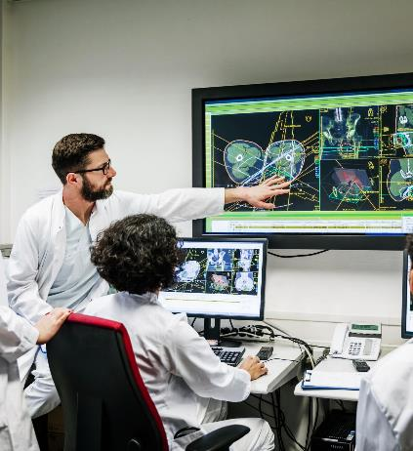
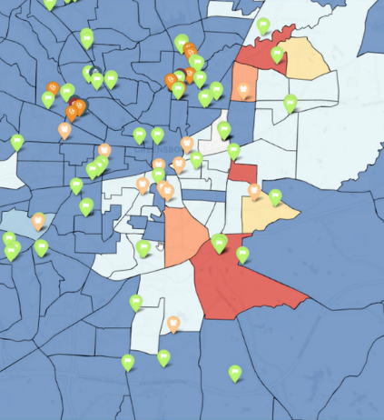
Opportunity:
Grant Focus
Create access to address preventable diseases early
Ensure practice-ready nurses and nurse practitioners
Expand experiential & multi-disciplinary learning
Use data science to identify care gaps in MUCs
Enhance nurse-led mobile health units’ service driven by data science to meet the health care needs of rural and underserved communities in the piedmont region of North Carolina,
Enhance the nursing curriculum and implement experiential learning in nurse-led mobile health units to address social determinants of health (SDOH) and improve health outcomes, and
Graduate nurses and nurse practitioners who can address the needs of targeted rural and underserved populations.
Notes:
Audrey

Slide 18
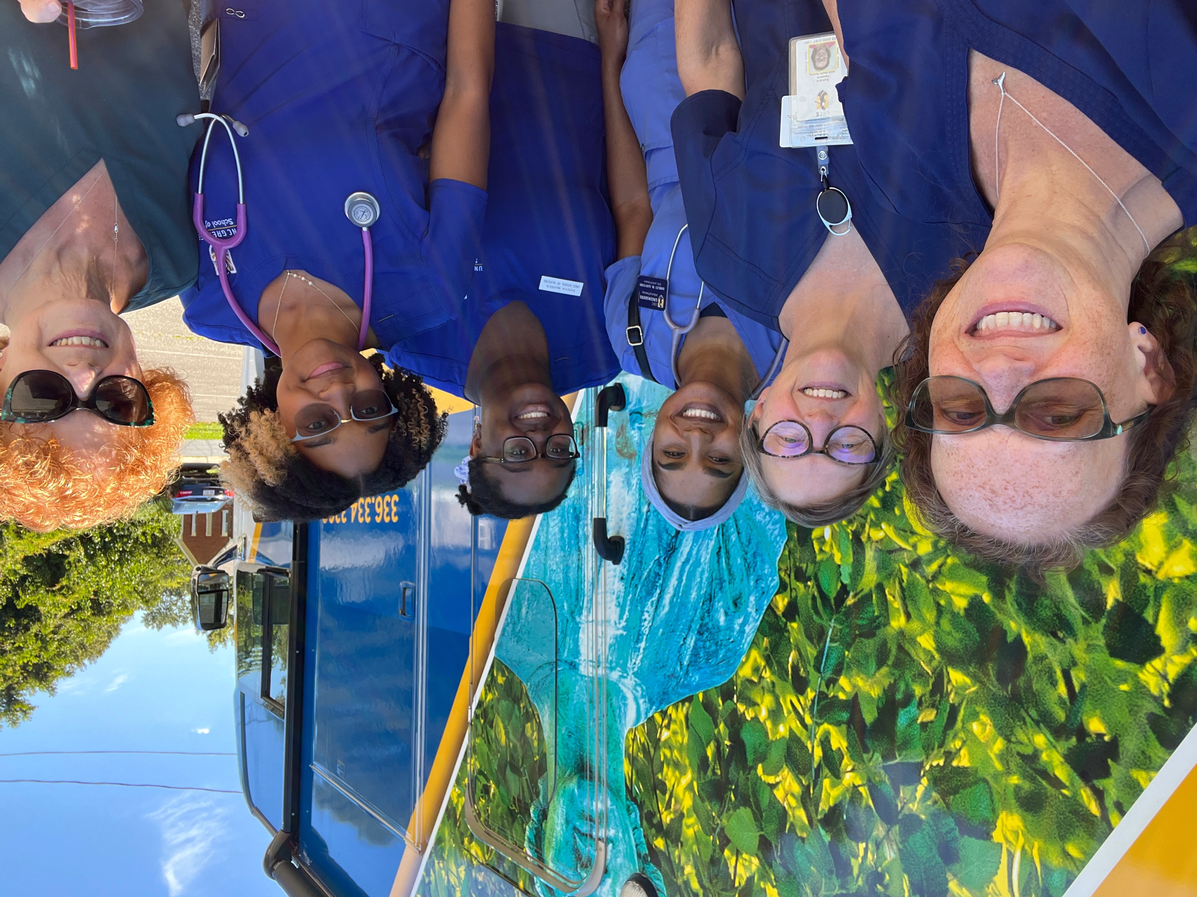
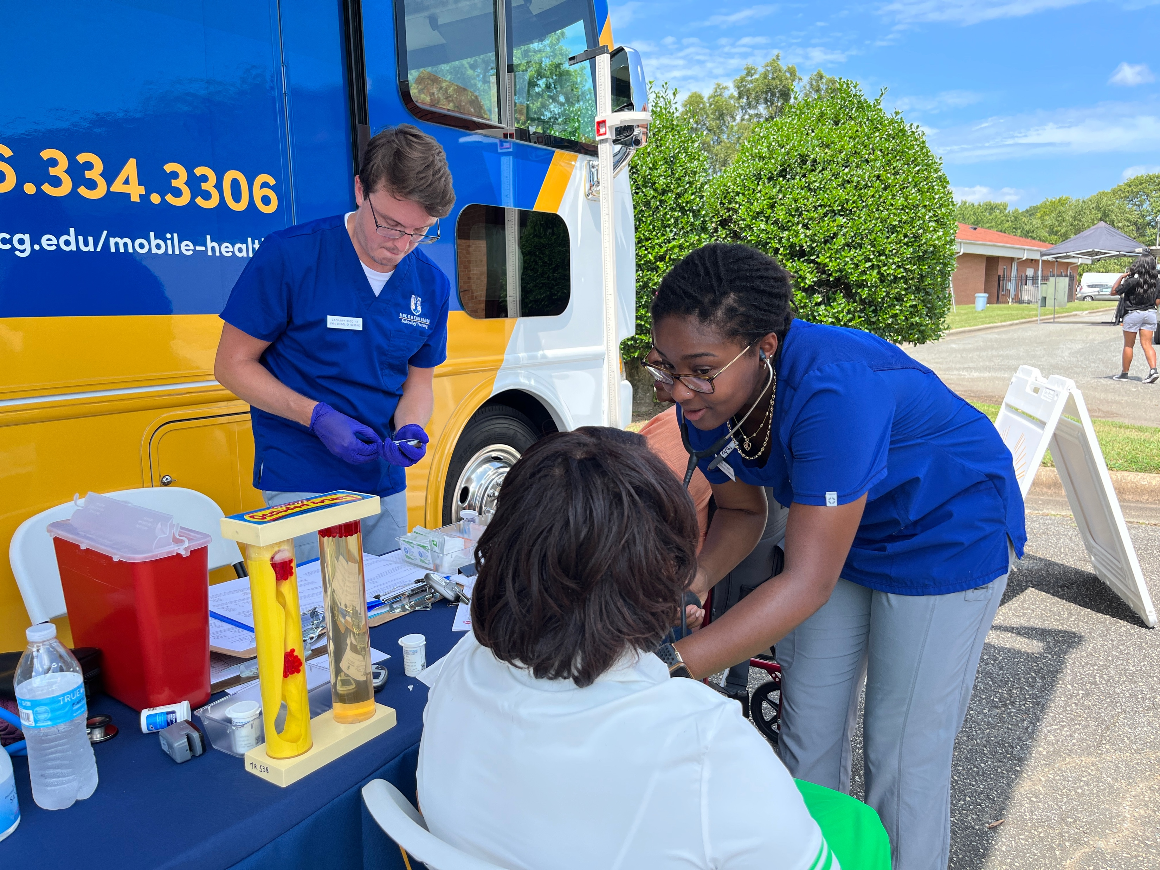
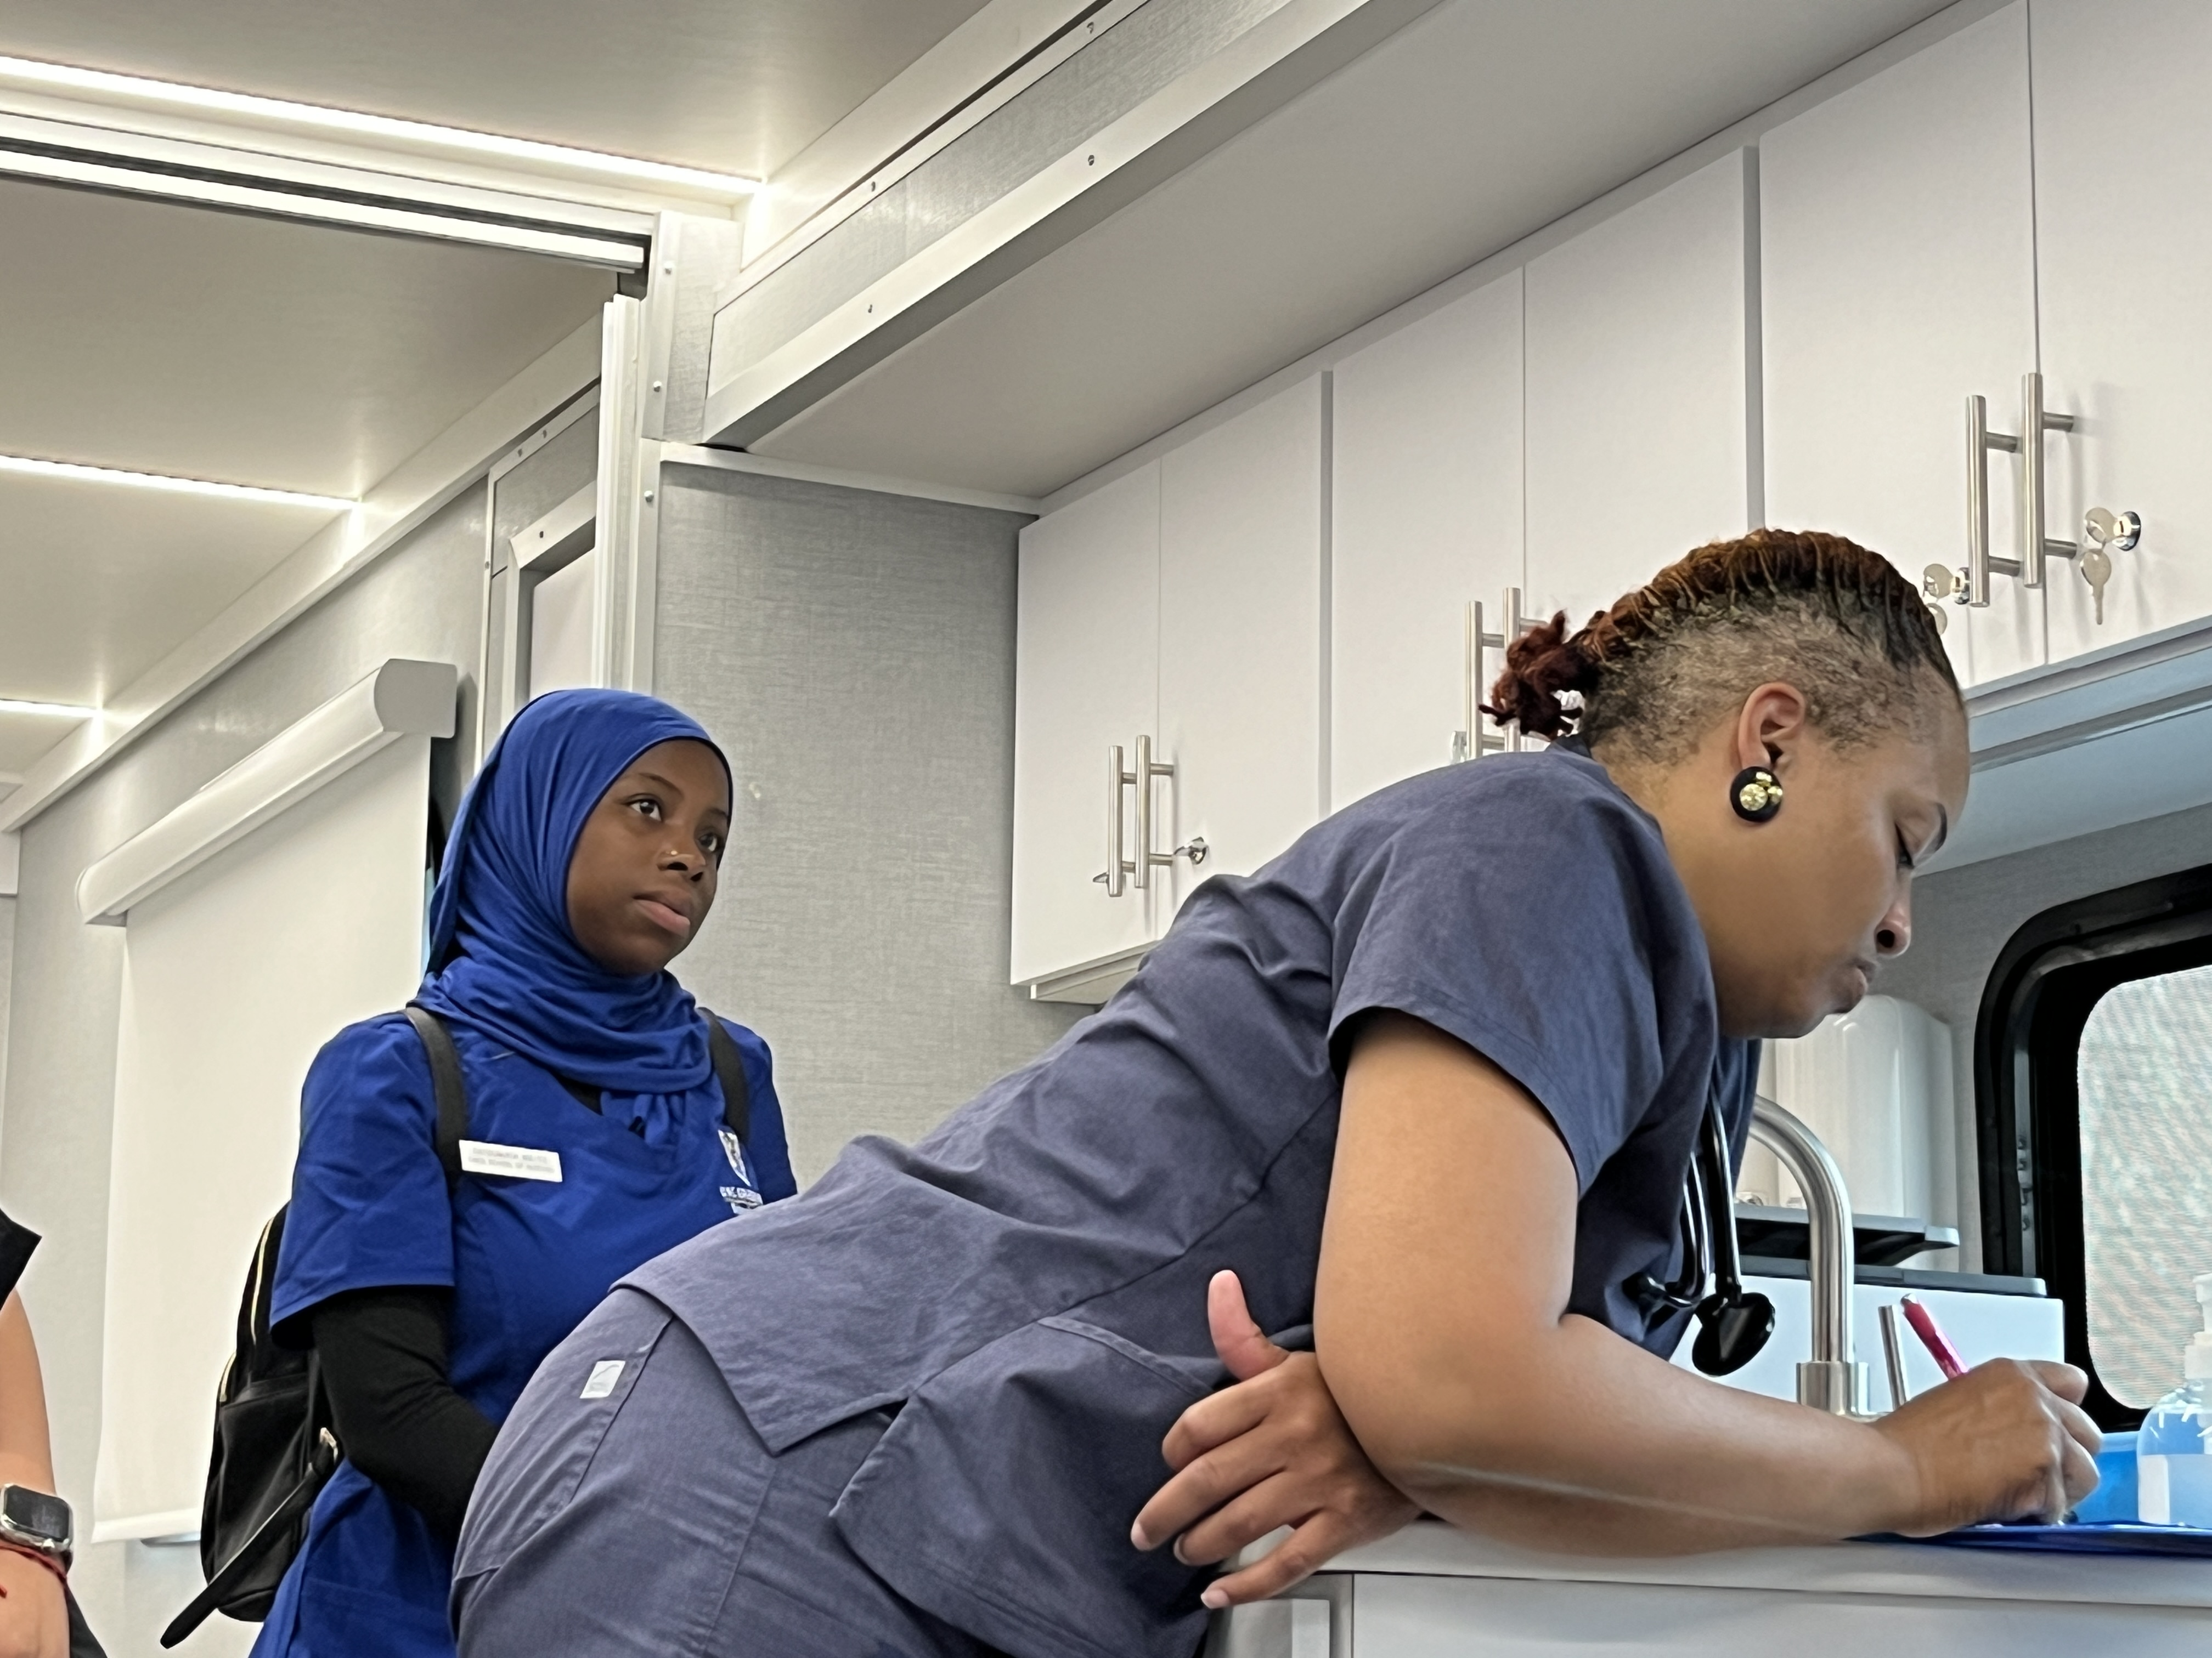
Community Integration - moving us toward the New Essentials Goals
All senior, and junior, and 16 AGPCNP student have participated in mobile health rotations.
Minerva’s Mobile Health has provided care in 8 counties in the Piedmont Triad during the 2024-2025 academic year.
Faculty and students cared for ~900 patients in the first 8 months of operation on Minerva’s Mobile Health.
Notes:
US 100,000 cases a day and 500 deaths a day.

Slide 19
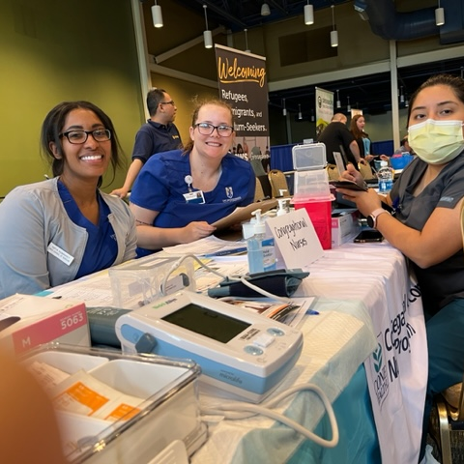
Expansion of Mobile Clinical Sites with Cone Health
Congregational nurse program - additional sites in High Point and Alamance County
BCCCP
Telehealth Primary Care
School based telehealth
Clara Gunn Center
Behavioral health Telepsychiatry

Slide 20
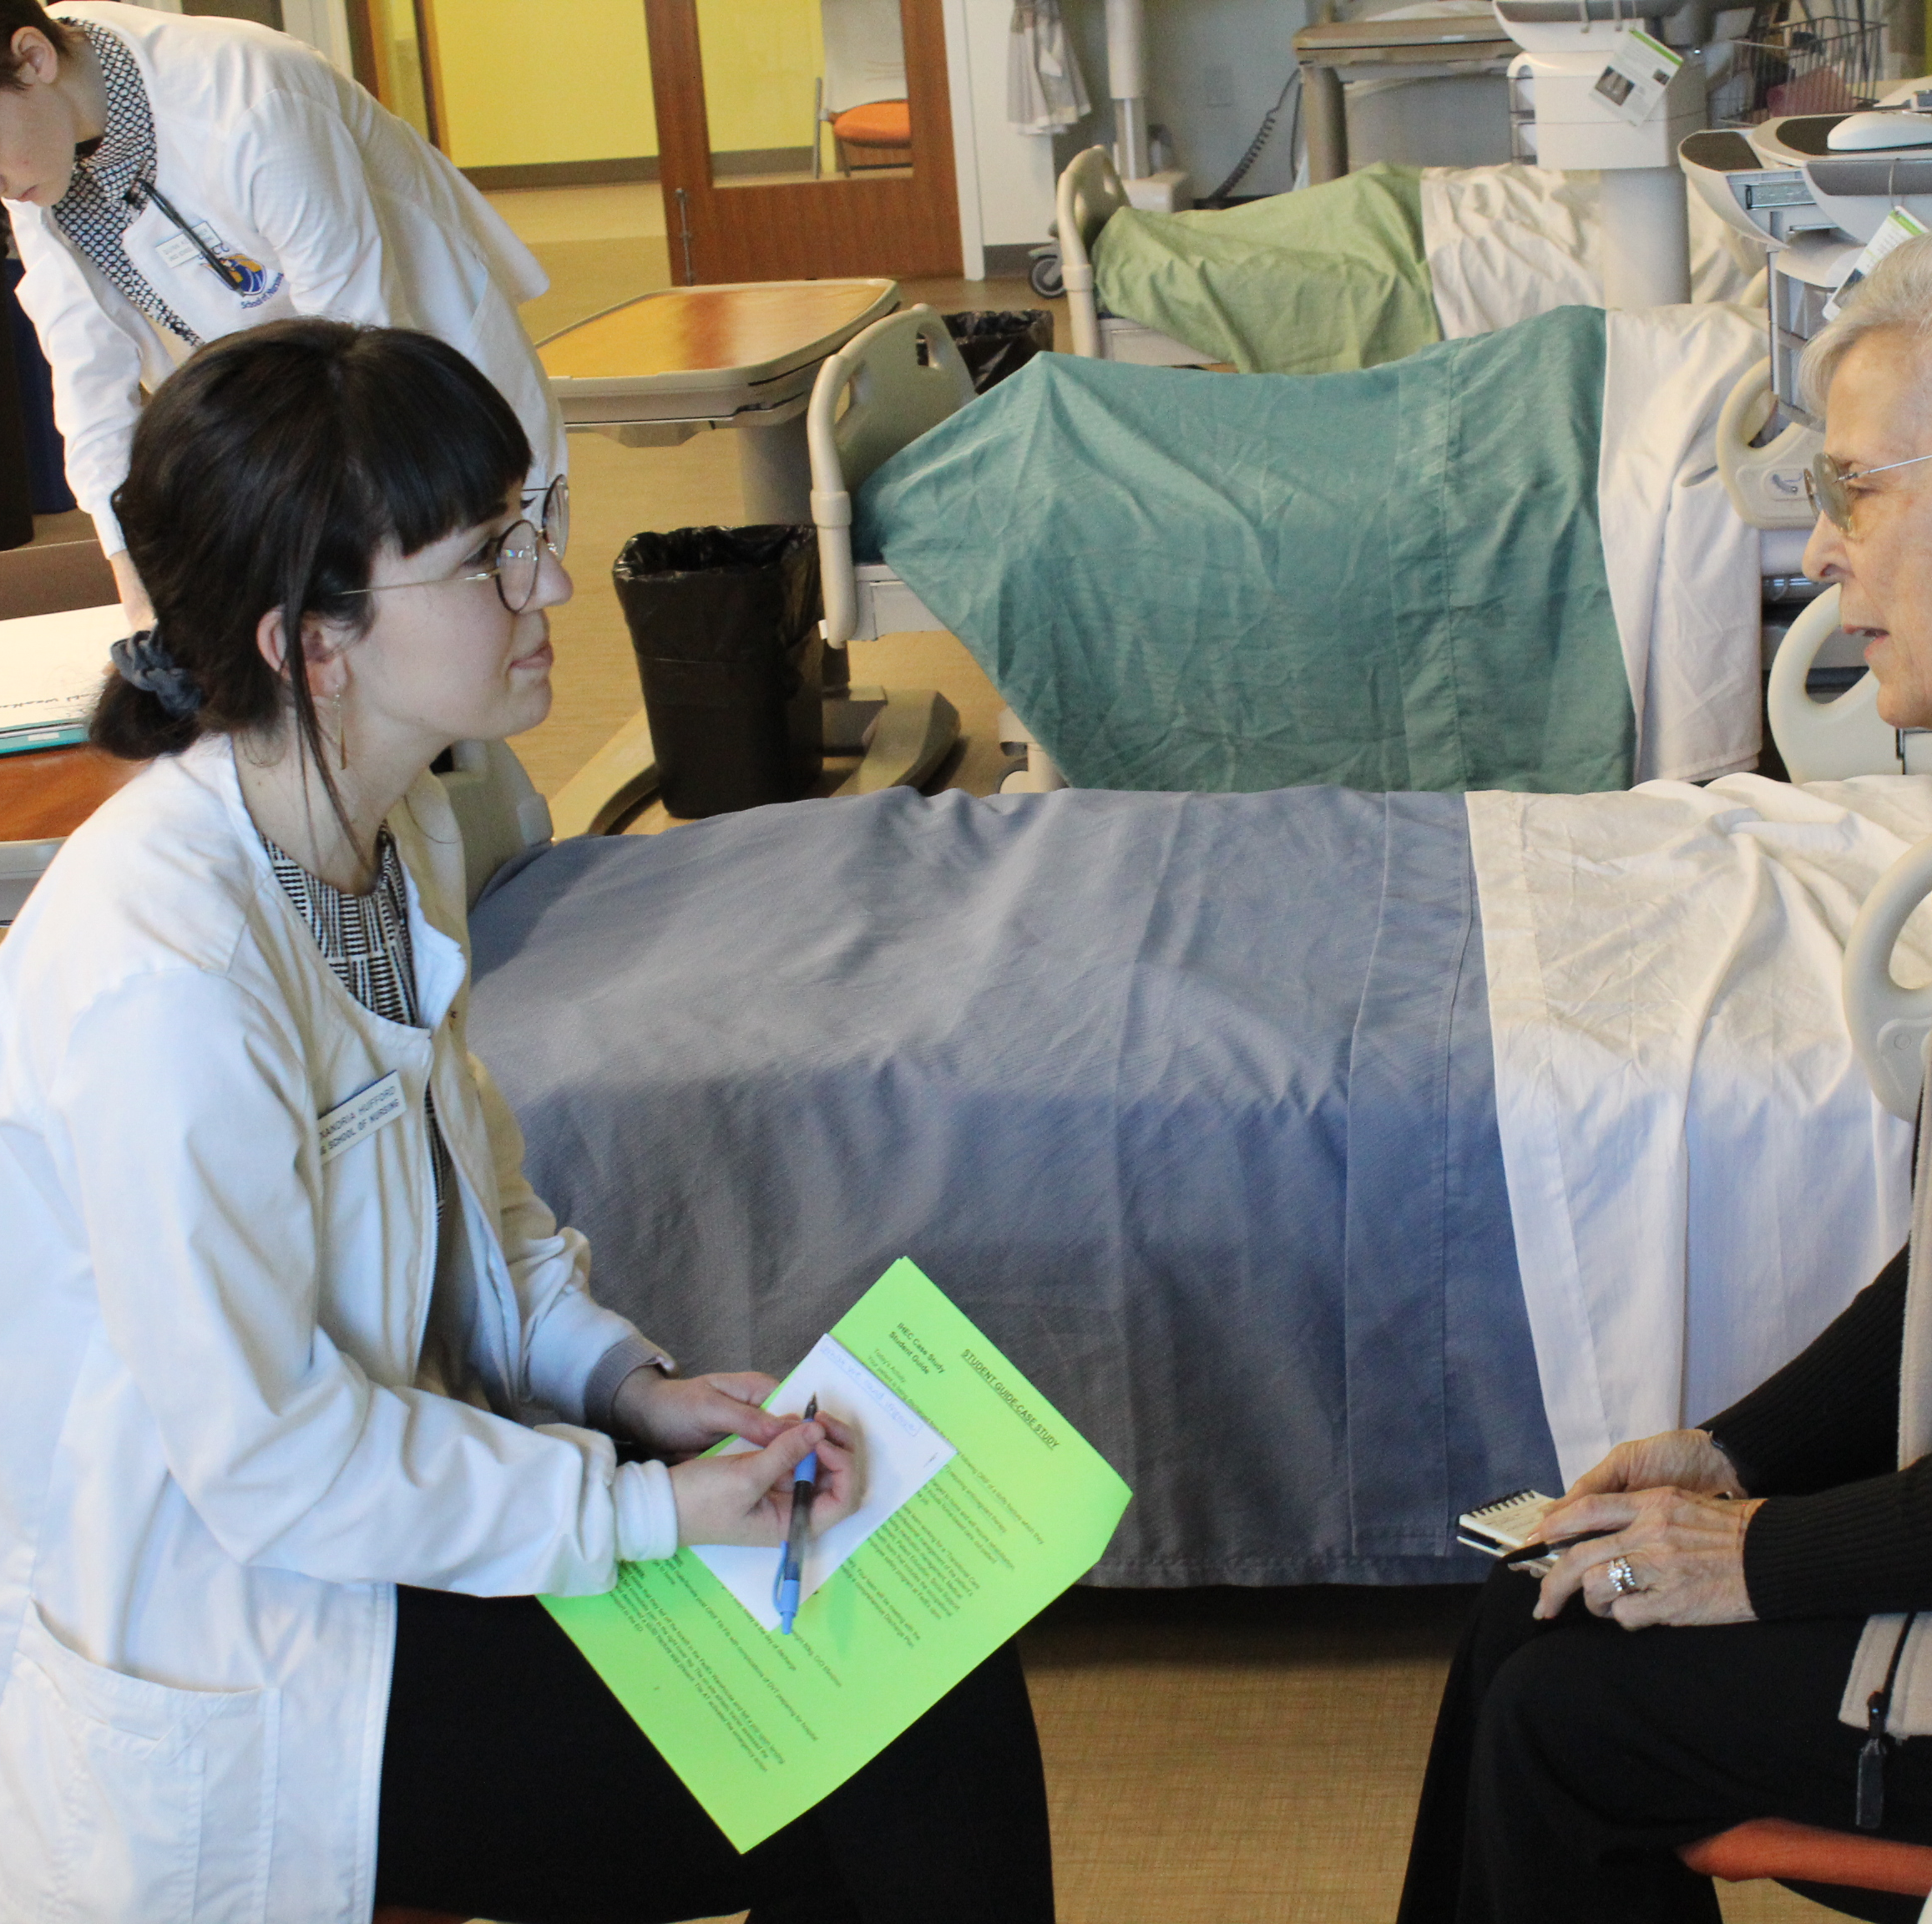
Integration of Telehealth into Practice: Enhancing Simulation to Improve Mental Health and Chronic Disease Management
Enhanced simulation scenarios that address telehealth, mental health, chronic disease and identified social needs of communities builds confidence and competence in improving health and well-being of populations and work towards reducing health disparities.
Strengthening partnerships with clinical and community stakeholders ensures provision of healthcare services in rural and under resourced areas.
Changes in nursing education fosters nursing professionals who feel competent and prepared to create a culture of health is essential to the future of nursing and the health of populations.

Slide 21

Charting a Path Towards Health Equity
Collaborate with Rural Communities
Assess strengths and needs of populations
Identify and confront social determinants of health (SHOH)
Engage with residents with mental health needs
Utilize and teach telehealth and technology skills

Slide 22
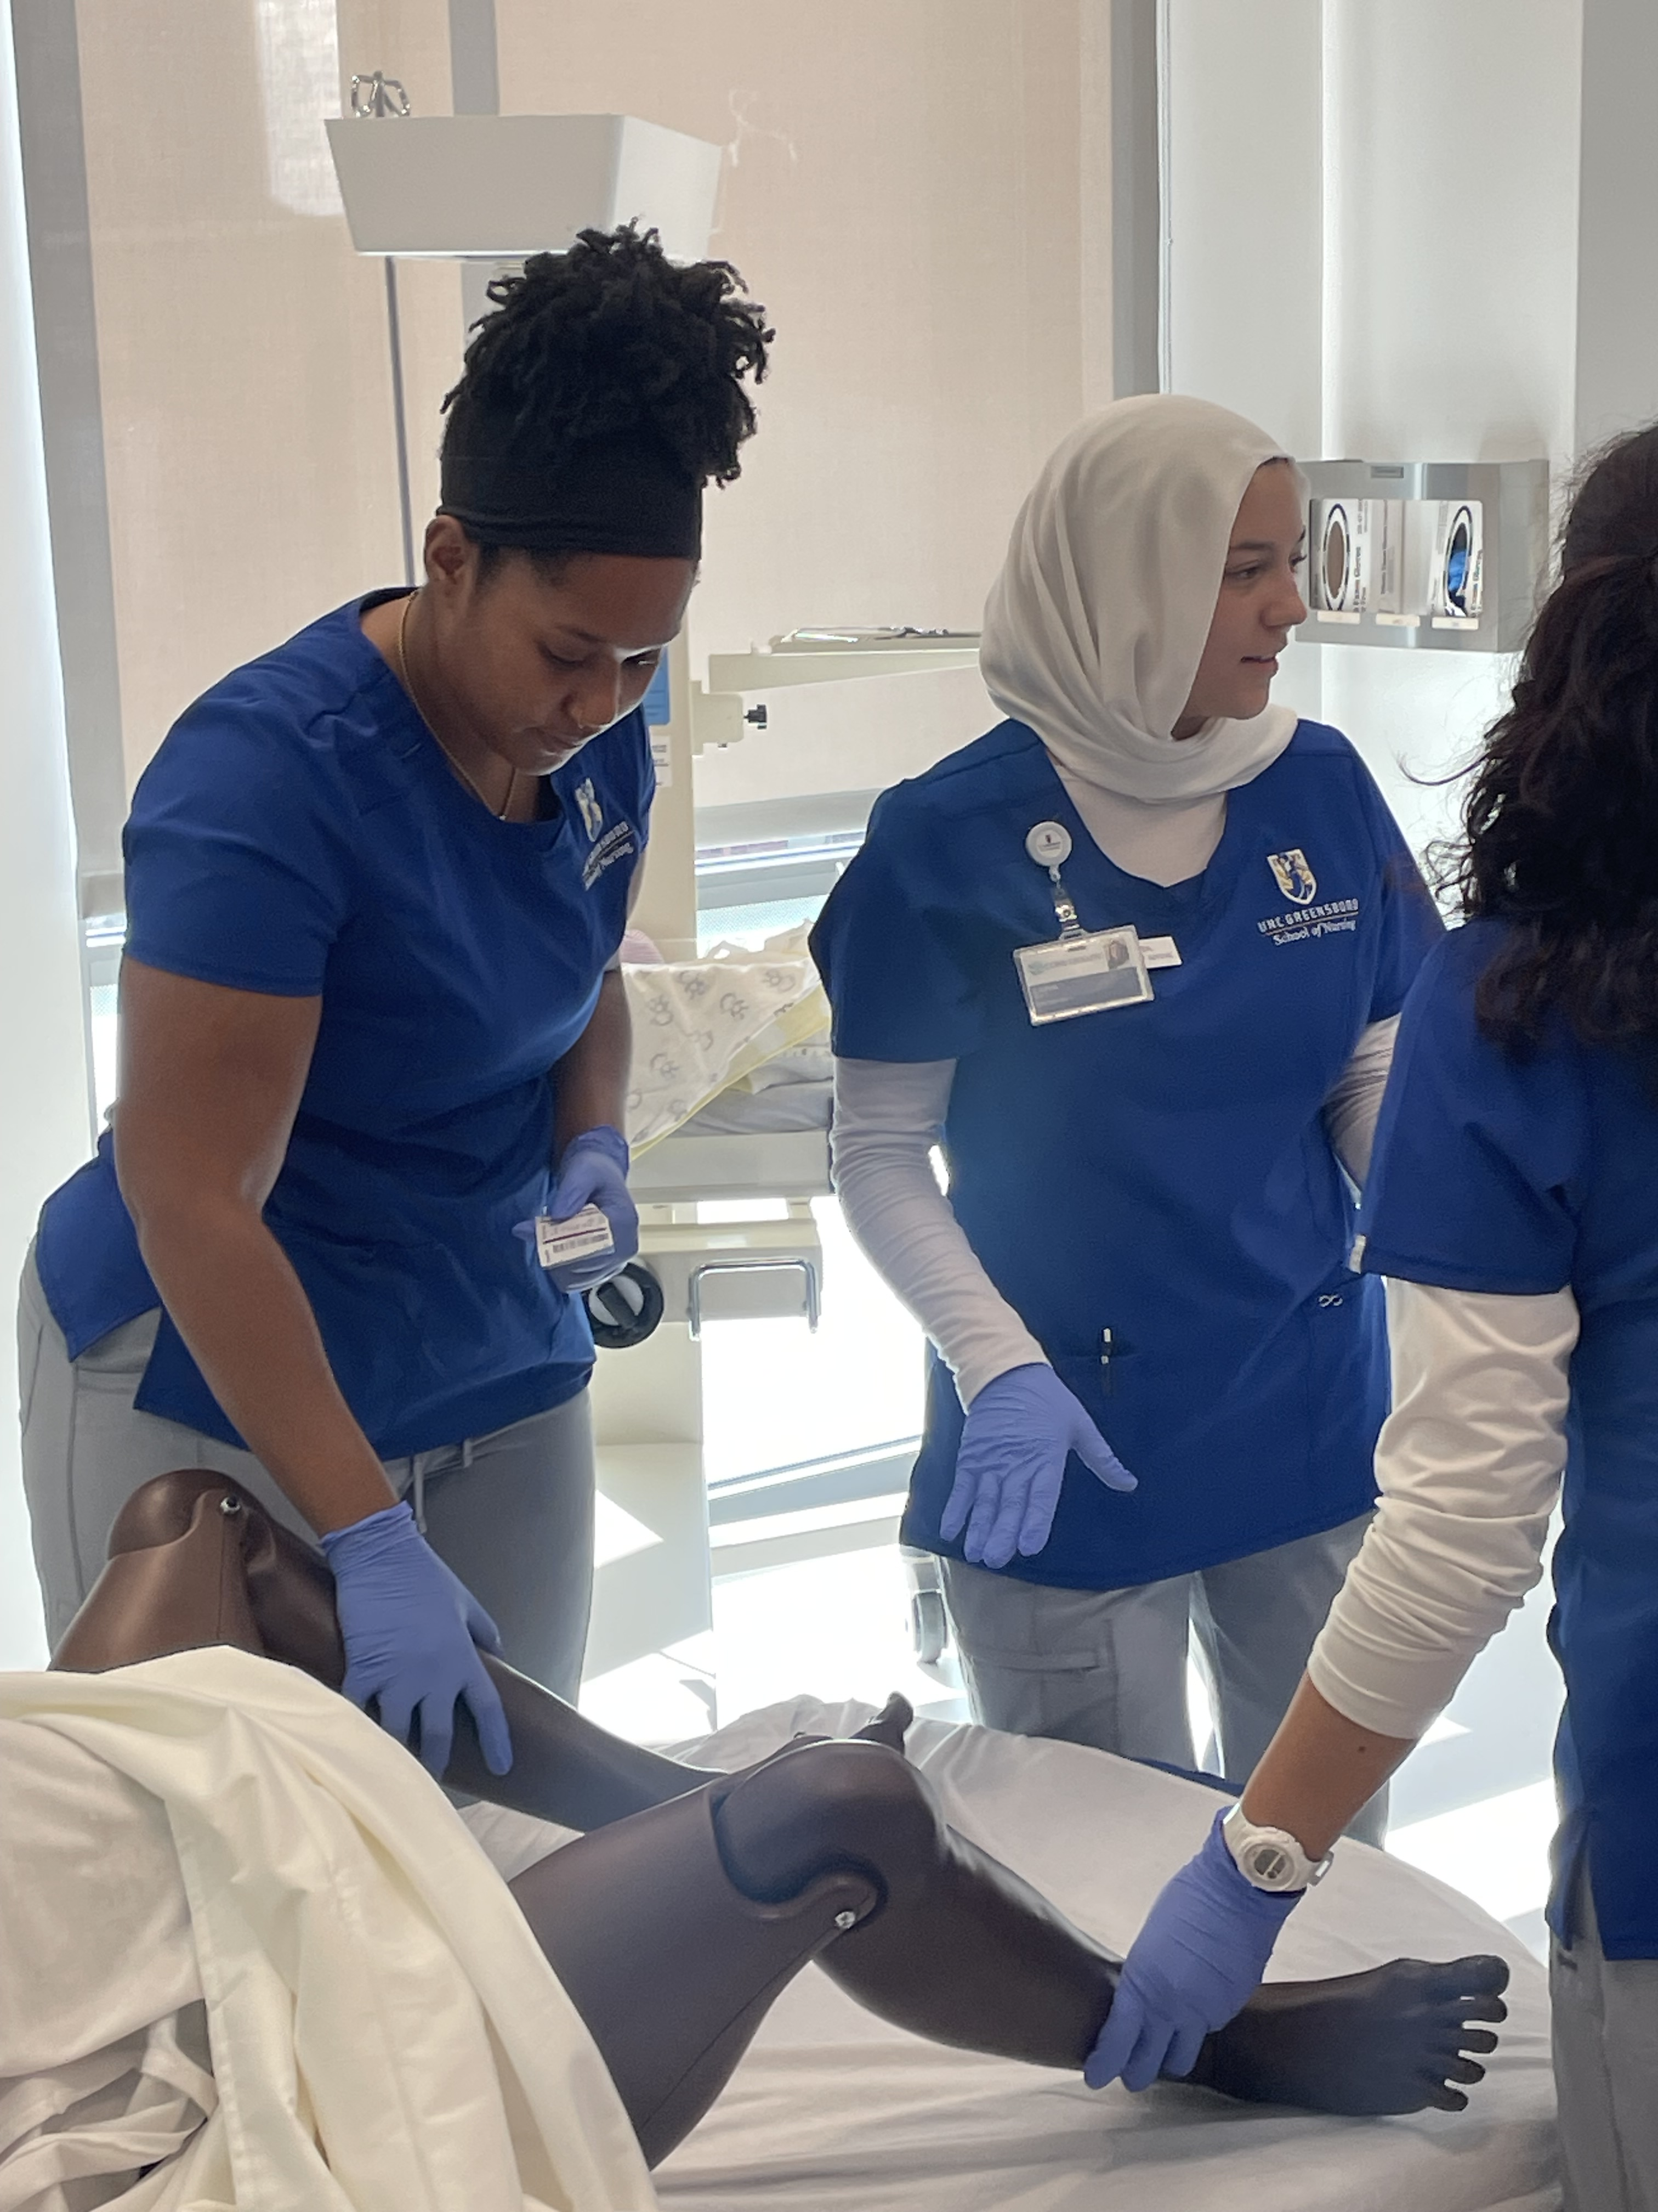
UNCG SoN SCENE (Simulation Center for Experiential Nursing Education)
Integrated telehealth throughout Doctorate of Nursing Practice (DNP) program simulation experiences, from acute care MSK clinic visits to chronic disease management & follow up
Delivered community-based Telehealth Education sessions aimed at older adults and under resourced communities
Implemented Mental Health, Telehealth & Community based simulation & reflective practice
Created reliable and measurable evaluation tools for learning effectiveness

Slide 23

Advanced Nursing Education Workforce (ANEW) Program
Dr. Williams
Purpose: To increase the number of primary care nurse practitioners, clinical nurse specialists, and certified nurse midwives trained and prepared to provide primary care services, mental health and substance use disorder care, and/or maternal health care.
Grants will support the training and graduation of advanced practice registered nursing (APRN) students/trainees in these disciplines.
Applicants are strongly encouraged to recruit students/trainees and faculty from diverse populations.

Slide 24
Strength of the Application
The application clearly describes the need to increase the diversity of primary care providers within the region.
The application thoroughly outlines the workforce's need to address chronic health conditions, social determinants of health, and health disparities within the target population.
The application provides charts, demographic data, and a narrative description of the targeted area that clearly demonstrated the purpose of the program.

Slide 25
Recommendation and Pointers
Accurate and current data is essential to help paint a picture of the problem and why you are best equipped to solve it.
Community & Population data
Community partners / supporters
Faculty expertise
Must show that you have the resources and support to carry out the program efficiently.

Slide 26

Questions for the Presenters: Facilitated by Debra Barksdale
How do you know about the HRSA Funding mechanisms?
How do you go about preparing to write a HRSA grant?
What are some common elements? (e.g., institutional resources, facilities, budget/ justification).
How do you share information with others in your school?
Do schools need a Research Office to Submit grants?

Slide 27

Campus resources
Office of Sponsored Programs (OSP)
  Boiler plate narrative on institutions and school (edit to meet this proposal mission)
  Who is allowed to submit the grant
  Back up your timetable for submission- often it is 2 weeks prior to due date
Student financial Aid
  Data on minority students
  Current funding awards
  Consider student tuition, fees and potential stipends
Review your school/organization website and social media accounts for accuracy
Notes:
https://brocku.ca/pedagogical-innovation/resources/open-educational-resources/

Slide 28
Questions Continued?
How long does it take to write a HRSA grant?
Do I need outside partner or collaborators?

Slide 29

In Summary
Sign up to receive email notifications of HRSA funding
Review prior RFPs and begin to formulate ideas
Know your community stats
Address funding priorities & preferences
Engage partners early
Include your grants management and financial aid offices early to work out processes before funding

Slide 30

Helpful Websites
HRSA
https://www.hrsa.gov/grants/apply-for-a-grant/prepare-your-application
HRSA Electronic Handbook
https://grants.hrsa.gov/EAuthNS/internal/home/EHBHome
Compliance
https://grants.nih.gov/policy/compliance.htm

Slide 31

Your Questions

Slide 32
Thank You
Djbarksdale@uncg.edu

